Slide 1
Performing Arts and advanced networking
Justin Trieger,
Director of New Media and Distance Learning
New World Symphony

Slide 4
About New World Symphony (NWS)
87 Fellowship Musicians, most post-graduate, for up to 3 years
100+ Concert Productions each year
Educational programs geared towards leadership, musical excellence, professional training, community outreach and entrepreneurship

Slide 5
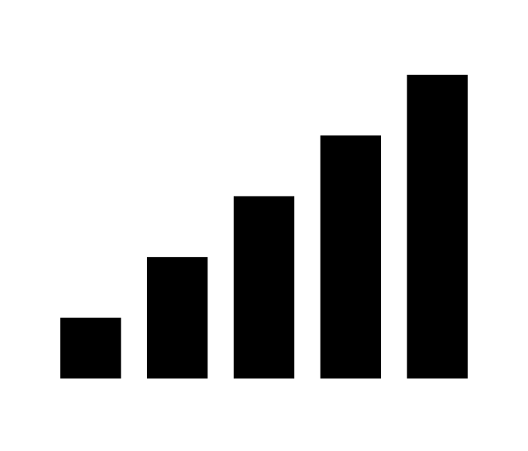
Requirements for Online Learning
Ease of Use
Audio/Video Quality
Latency
Accessibility

Slide 6
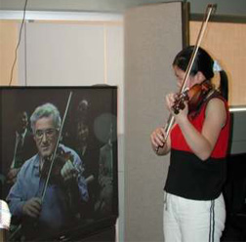
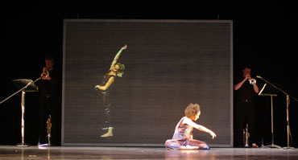
Initial Experiments with H.323

Slide 7
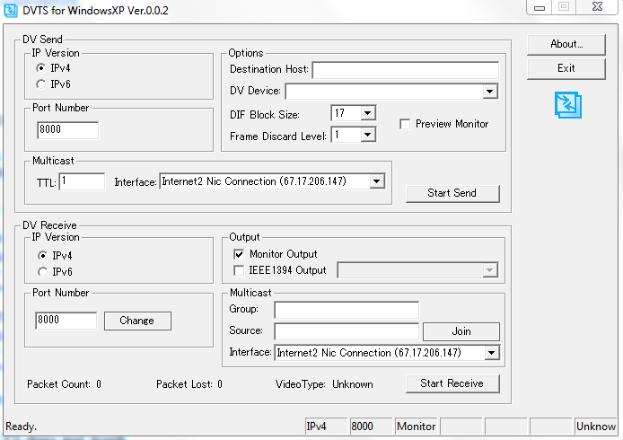
DVTS (Digital Video Transport System)
DV Specification
FREE
Simple Interface
Windows Only

Slide 8
DVTS – The Good
Stereo, uncompressed 44.1Khz PCM audio
720 x 480 resolution
Multicast enabled
Low-cost

Slide 9
DVTS – The Bad
200ms+ latency
Standard Def
No error-correction (UDP)
No echo-cancellation

Slide 10
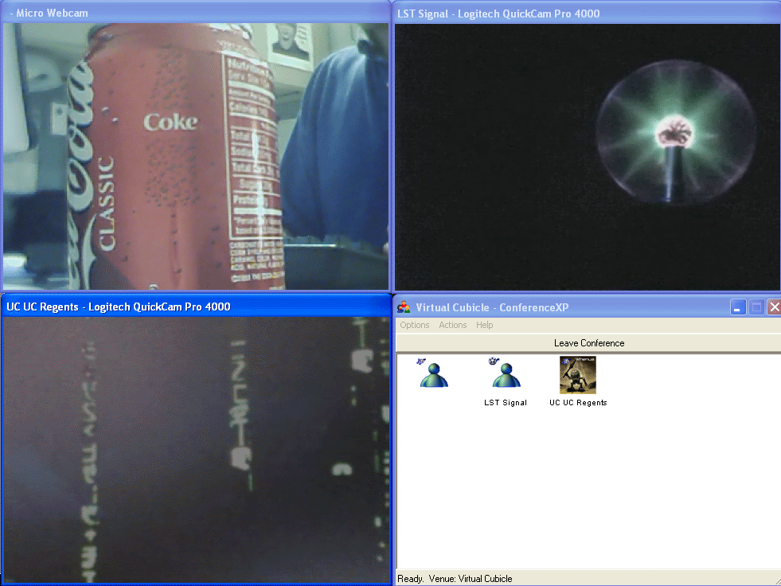
ConferenceXP
Originally developed by Microsoft
FREE
Windows Only
Now open-source and maintained by University of Washington
200ms+ latency
Standard Def
No error-correction (UDP)
No echo-cancellation

Slide 11
ConferenceXP – The Good
Works with most consumer and professional devices
Variable bandwidth allocation for audio and video
Easy multipoint
Security transversal possible
200ms+ latency
Standard Def
No error-correction (UDP)
No echo-cancellation

Slide 12
ConferenceXP – The Bad
Only works well on Windows/ Bootcamped Mac
Only uses antiquated compression scheme out-of-the- box for video
Heavy CPU utilization
P2P connections are buggy
200ms+ latency
Standard Def
No error-correction (UDP)
No echo-cancellation

Slide 13
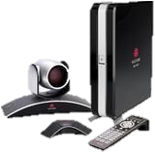
H.323
Low-bandwidth
Ubiquitous in higher education
Commercial solution
Secure

Slide 14
H.323 – The Good
HD Resolutions
Low bandwidth
Error correction
Easy Multipoint
Onboard Echo Cancellation

Slide 15
H.323 – The Bad
Best sounding codecs are proprietary
Expensive
Onboard Echo Cancellation
Awkward handshaking between manufacturers

Slide 16
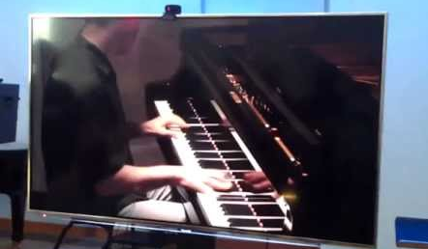
Ultragrid
Software solution
Developed by Czech R&E network in 2002
More commonly used in medical applications

Slide 17
Ultragrid –The Good
Uses commodity PC and Mac hardware
Support for up to 8K resolution
Excellent support
Works on a variety of OS

Slide 18
Ultragrid –The Bad
Command line operation
Tricky installation depending on OS
OK latency, 100ms+
Requires a good deal of bandwidth

Slide 19
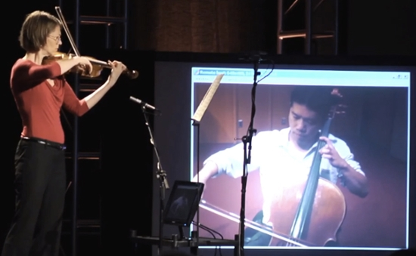
LOLA
Originally released in 2011 by GARR
Windows only
Color or B&W video (to conserve bandwidth)
Growing international user group

Slide 20
LOLA – The Good
Variable video resolution (480 – 1200p)
Multi-channel audio support
Super simple GUI
Works with professional audio gear

Slide 21
LOLA – The Bad
Requires 20 – 800Mbps
Does not play well with firewalls
Multi-point not yet released
Requires extremely specialized USB3 cameras

Slide 22
Ease of Use

Slide 23
Audio/Video Quality

Slide 24
Latency

Slide 25
Accessibility

Slide 27
Current Challenges
Solutions are either too expensive, too complicated or require substantial bandwidth
All solutions still require some understanding of audio, video and lighting in order to be impactful
The network is slowing us down
Display technology is still not perfect
Ethernet dependent

Slide 28
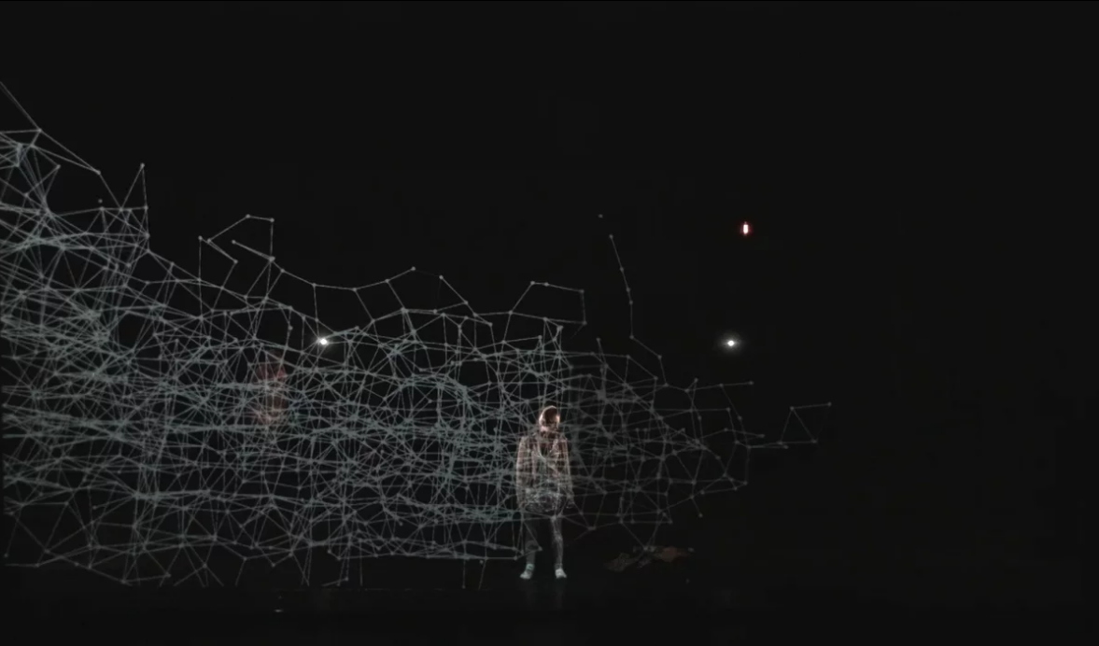
The Infinite Bridge

Slide 29
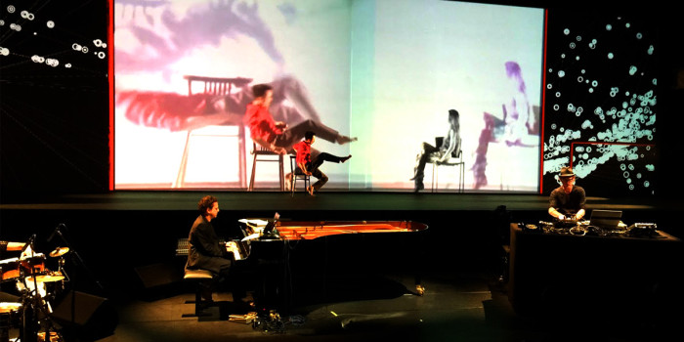
Near in the Distance

Slide 30
Global Audition Training Project

Slide 31
What’s Next?

Slide 32
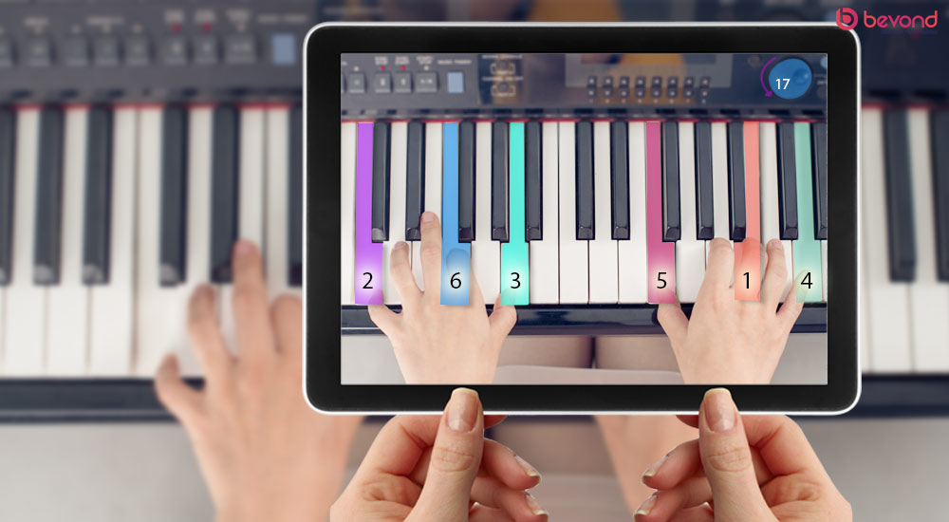

Slide 33
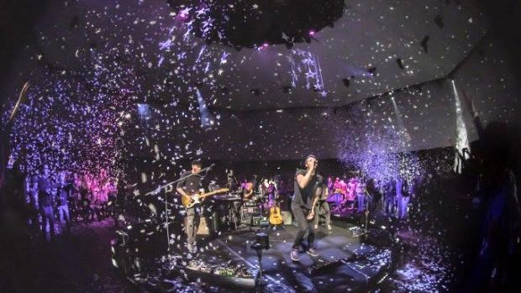

Slide 34
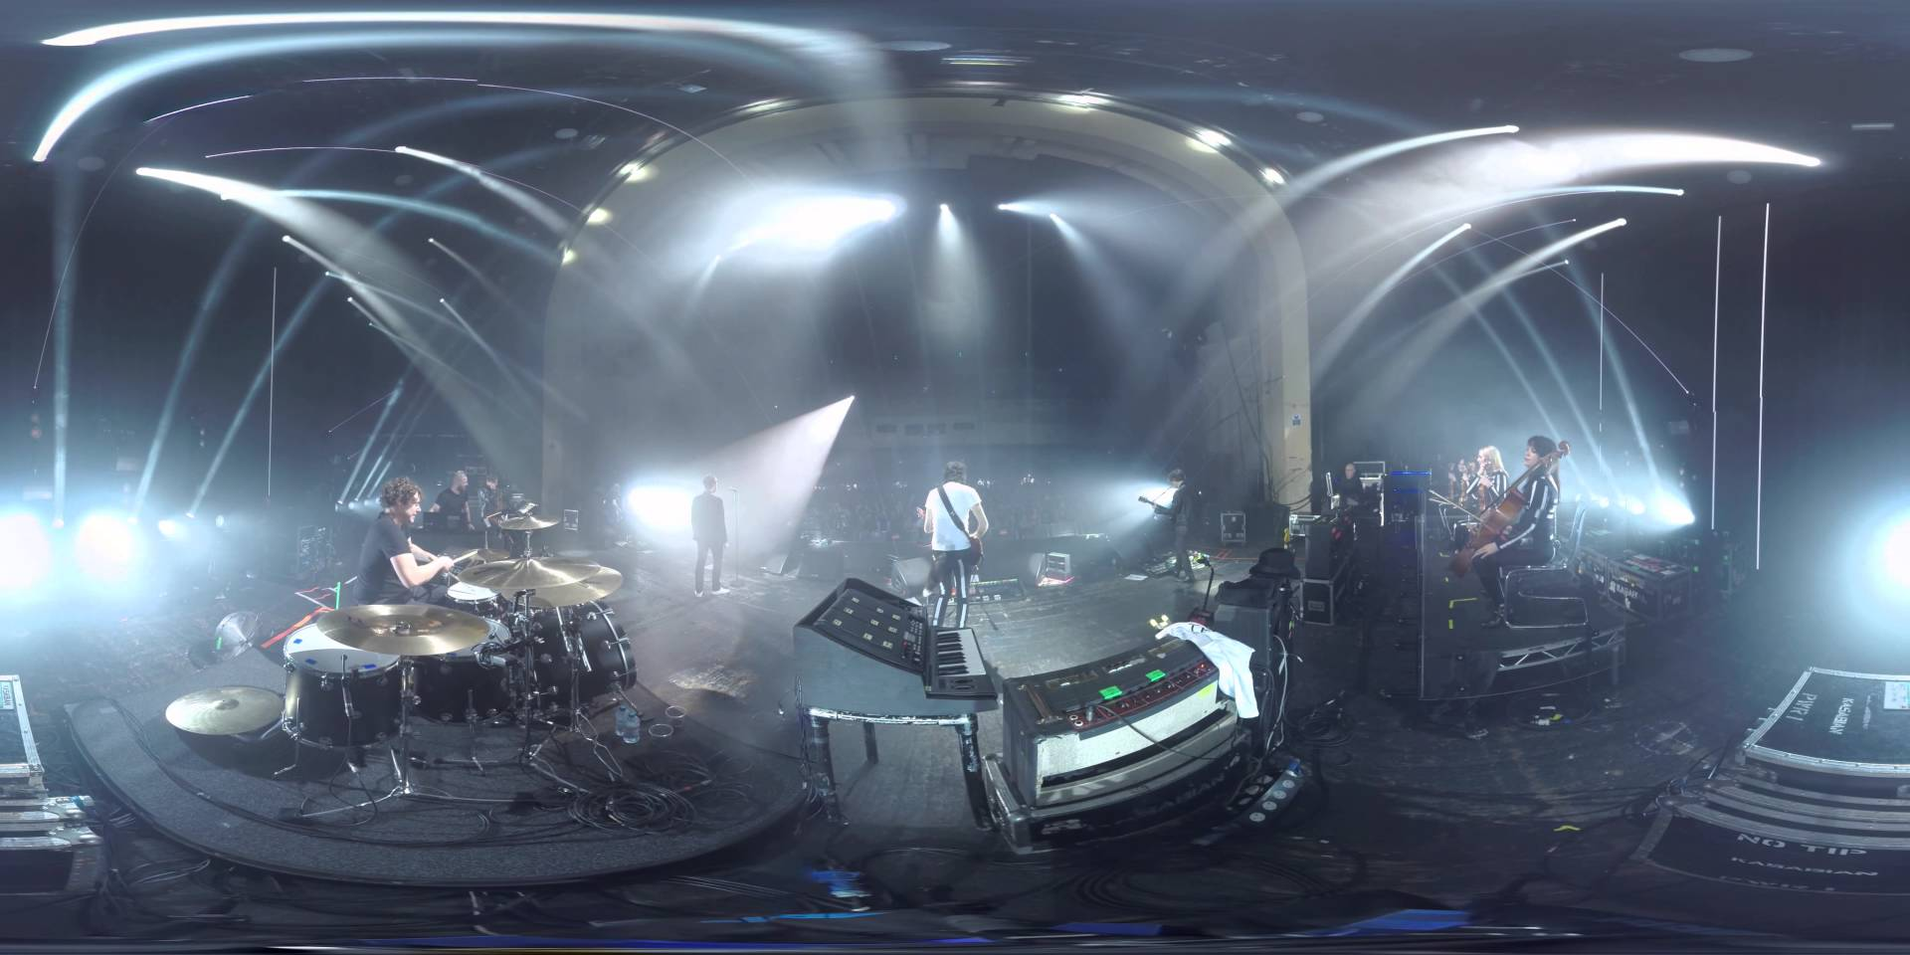

Slide 35
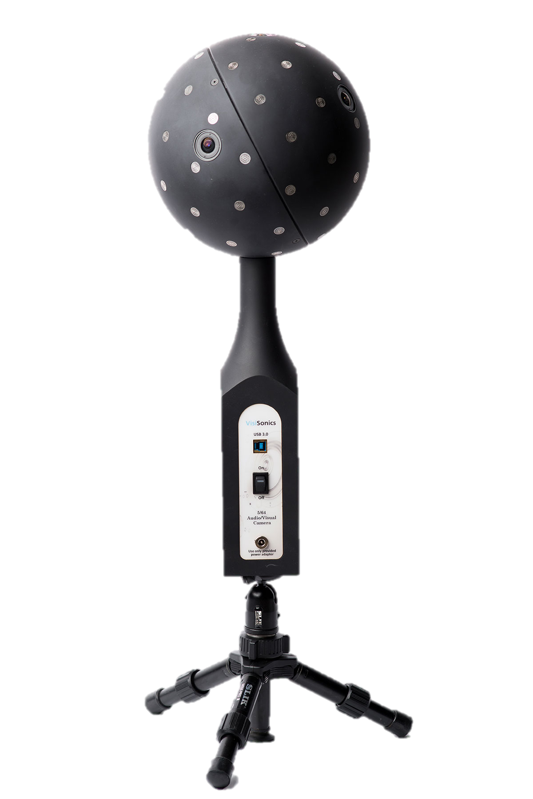
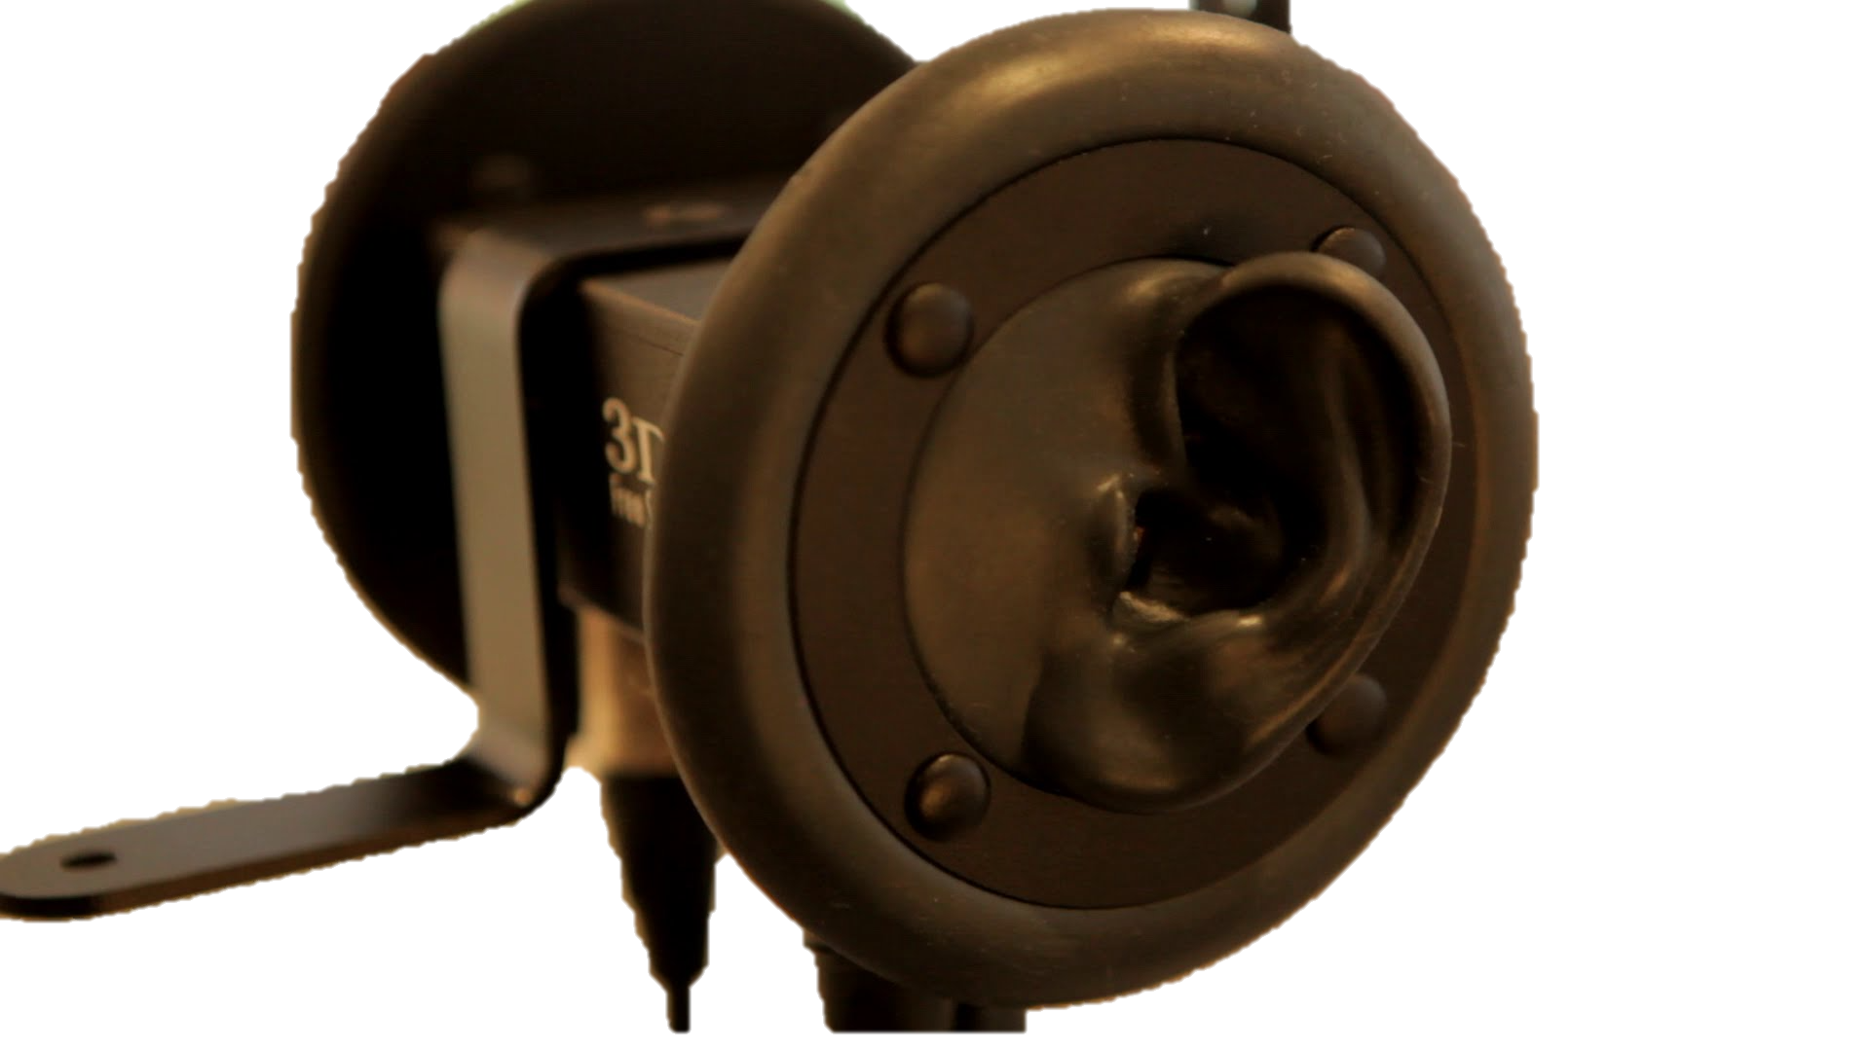
Binaural Audio
Ambisonics

Slide 36
Justin Trieger
Director of New Media and Distance Learning
Justin.trieger@nws.edu
305-428-6756
John Henry Dale
Manager, Distance Learning and Information Technologies
Johnhenry.dale@nws.edu
305-428-6762

