Slide 1
CORIOLANUS/LEAR ONLINE
THERE IS A WORLD ELSEWHERE
Notes:
Spoken by Coriolanus on his exile from Rome, this phrase began to become the mantra for the whole project. It changed from a threat (Coriolanus means he will ally himself with the Volscians) to mean the immersive space we had created together.

Slide 2
OBJECTIVE
Online International Learning
Acting in a foreign language
Shakespeare 400
Promoting Intercultural dialogues
Notes:
Project origins began as an OIL project in acting in a foreign language (Finnish and English)
Use of Shakespeare levels the playing field as the complexities of archaic Shakespearian language and the discipline of working with blank verse meant that the English students were not advantaged
The politics of the scene – Coriolanus and his disdain for the people.
The manipulation of the populous by the politicians to gain power.
The idea of the citizen in the digital age.
Who are the mob now? (Facebook/Twitter)

Slide 3
APPROACH
The challenge of having a series of international theatre workshops 1125 miles apart
Use of apps and Social Media for lectures/small group work and timetabling
EXTRACT/INSERT Inspiration
Polycom on UK side, Tandberg in Finland
Videoconferencing/Rear-projection/Directional sound
The illusion of a unified space
Notes:
Traditional methods were not sufficient for rehearsal work
Could synchronisation even be achieved?
Talk briefly about Second Life inspiration
The importance of an invisible and intuitive interface that enables ‘business as usual’
Apps used for rehearsal/communication and the social aspect

Slide 4
Notes:
Everything (except the camera) is hidden behind the screen which is ‘flatted off’ - think stage set - to give the impression that this is the other side of the room.

Slide 5
“The Eyes Follow You Around the Room”
Notes:
The camera gives the illusion of eye contact
The initial error was to pretend that the camera was not there - this was not a traditional theatre rehearsal

Slide 6
ENGAGEMENT
Two week course
Six groups each with own ‘Virtual Rehearsal Room’
Supported by Contextual interactive lectures
Tutors in both spaces - not one way teaching
Morning workshops and experimentation in large space
Notes:
The app use is vital - each group has a limited time in the space so the apps not only help the rehearsal process but also provide a way of socialising and building trust amongst the cast
The space functions in the same way as a theatrical set - actors use their imagination to overcome the disconnect
Echo problems in wind tunnel space - very apparent when watching video footage from other side
Latency exists in acting - the actor needs to hear, think and respond

Slide 7
Virtual Beer
Notes:
How to solve the problems of the post show drink…

Slide 8
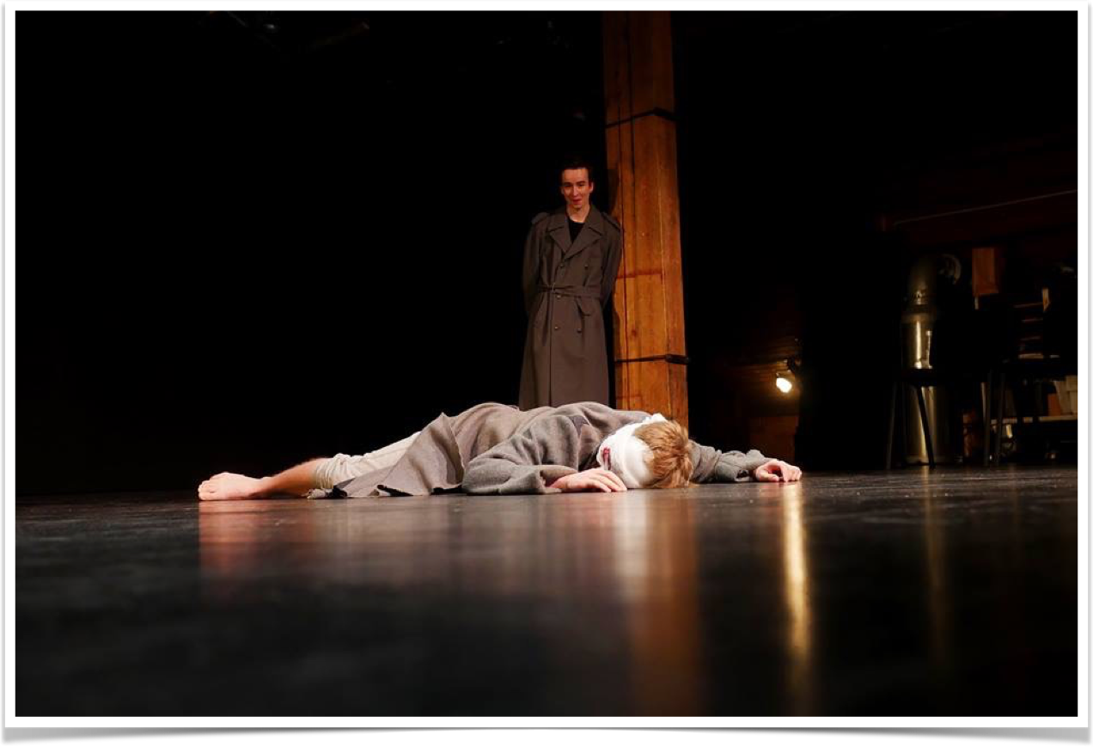
LEAR ONLINE
Notes:
Political factor (Brexit) and level of challenge of text

Slide 9
FROM VIRTUAL TO LIVE
Two week process - Online week and Live week
One group had worked with the tech before, the other was new
Matching Polycom GS500 units on both sides
Adobe Connect and Facebook used to support sessions
Plan to explore what could be achieved in the telepresence space
Networks configured using ‘Science DMZ’ principles
Live performance (and live-streamed) in Tampere
Notes:
Decision to rehearse with a purpose
Focus was to see what could be achieved in the immersive space in order to facilitate live performance
10 day gap with students continuing work via adobe/Skype/Facebook
Decision not to repeat any activities from previous year - singing, body awareness, martial arts, yoga all part of the morning workshop sessions

Slide 10
WHAT WE LEARNED
Intimate scenes can be developed using the camera creatively
The limitations of the technology can lead to creative solutions
The telepresence space encourages experimentation
Focus in rehearsal is increased
The technology and International aspect accelerates the rehearsal process
Notes:
Dover Cliff scene experiment
‘We want to stand on chairs’
Use of the camera to provide size and perspective
The camera encouraged an interesting use of space - Lear in isolation
The frustration of not being able to touch worked for the characters
Students as partners in the learning process
Facebook and iPhone a good way of sharing images/videos from both sides in an informal way

Slide 11
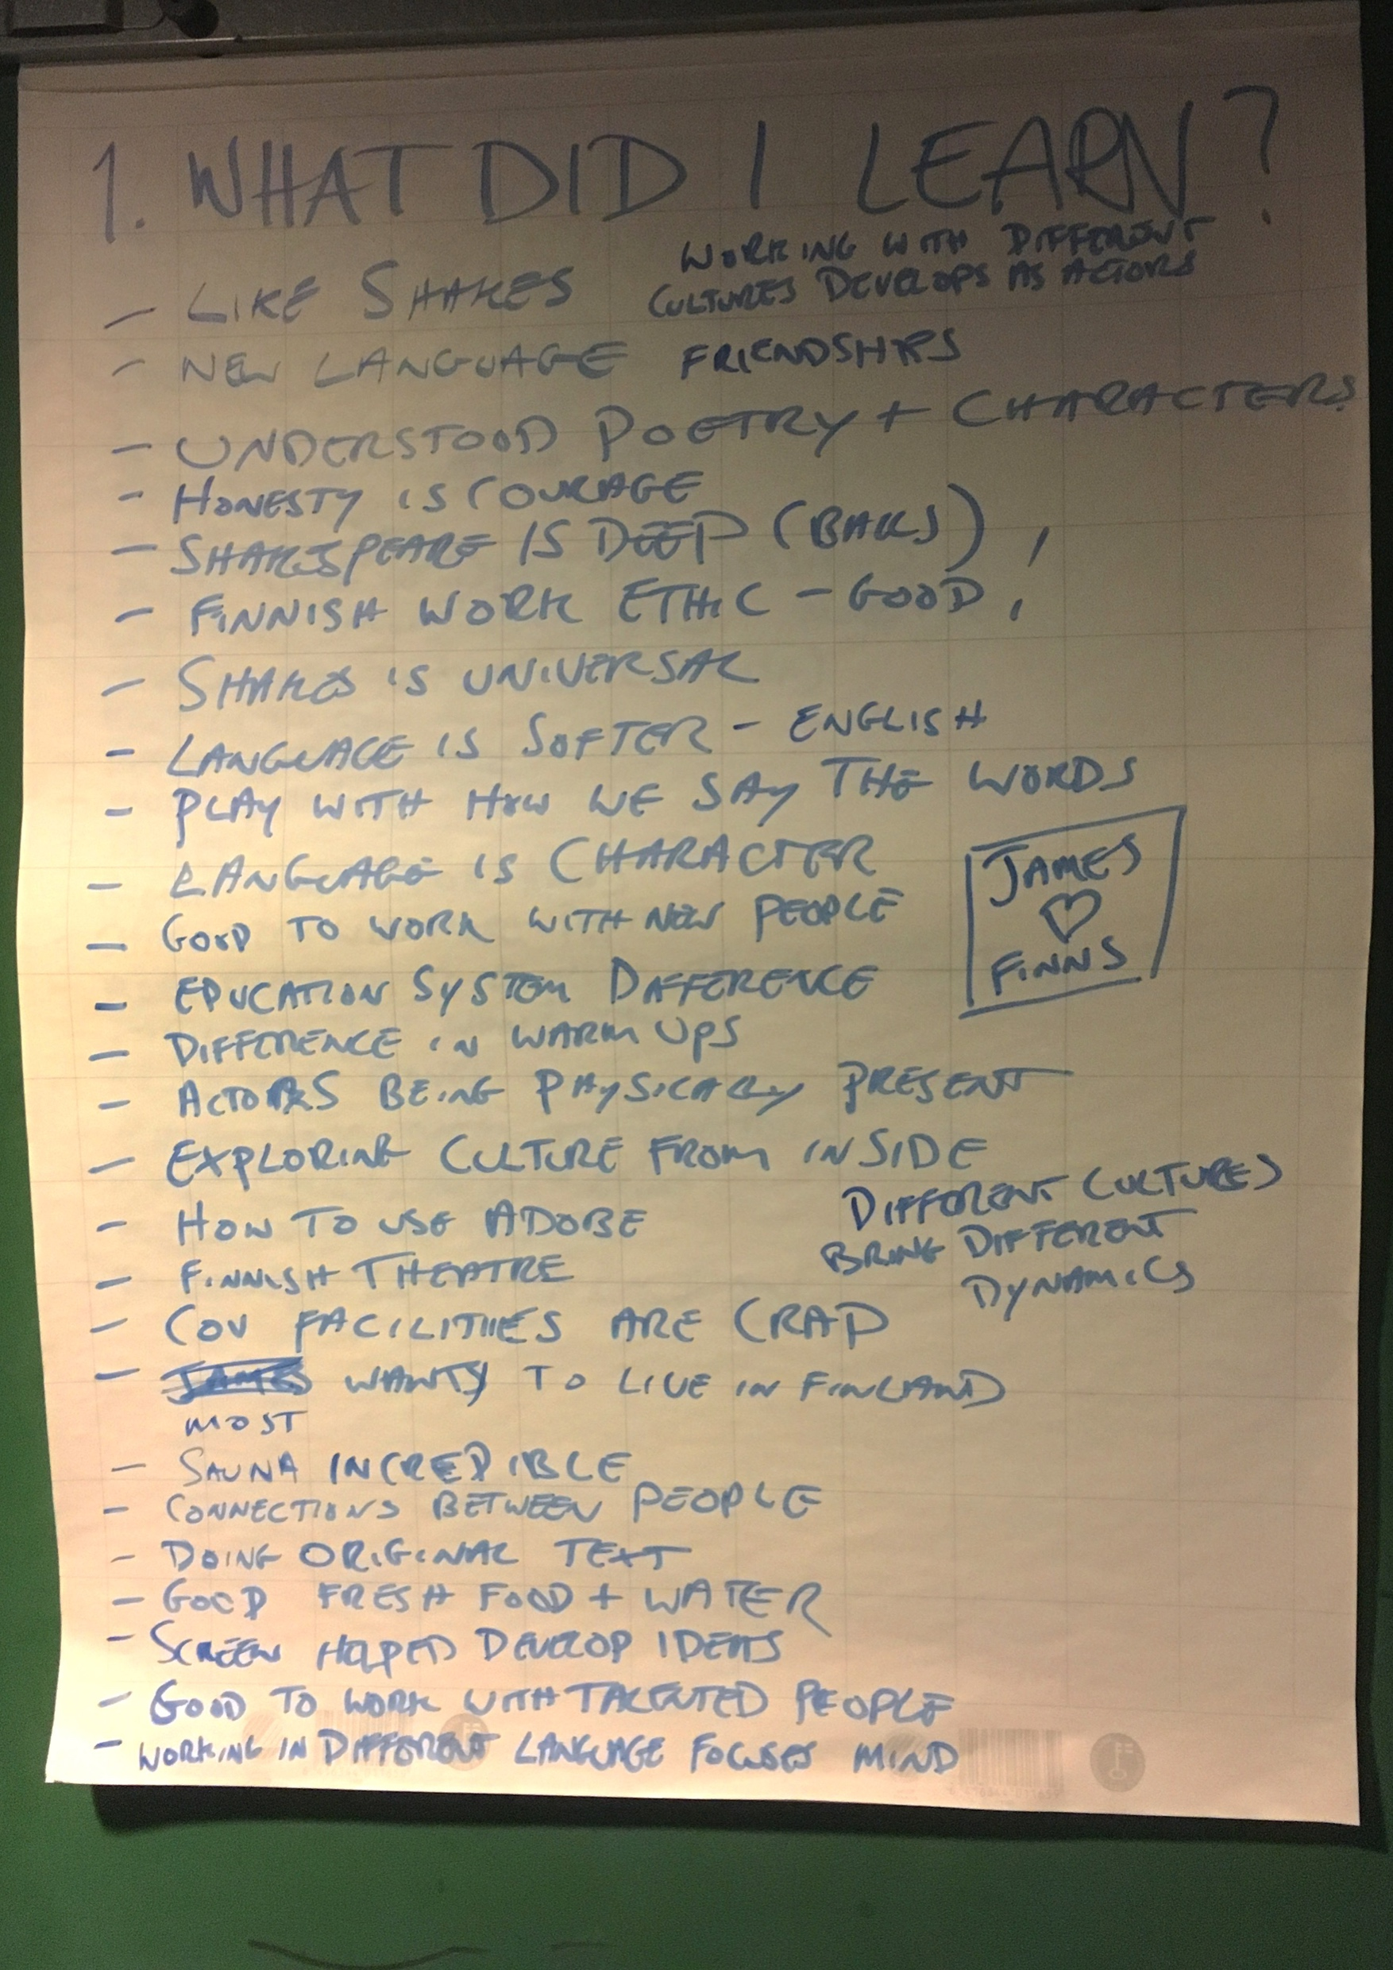
Notes:
Working in foreign language enables the actor to physicalise and play with the sounds of words

Slide 12
ANY QUESTIONS?
http://telepresenceintheatre.coventry.domains

