Slide 1
Network delay management for collaborative applications in performing arts
Sven Ubik, Jiří Melnikov
Adapted from GLIF 2015 presentation, version January 2017

Slide 2
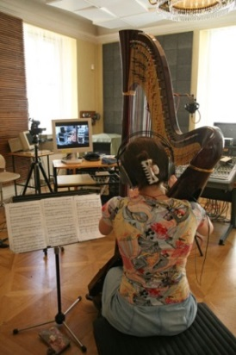
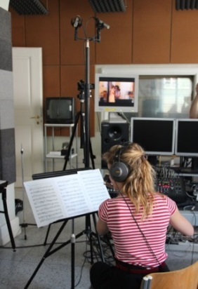
Motivation
Low-latency audio and video transmissions can enable real-time collaboration in various areas. Accepted delay of the system depends on the application.
For general interactive work, 150 ms response is considered comfortable (ITU-T Recommendation G.114)
For playing music together, max. 15-30 ms can be tolerated, depending mainly on music style, musical instruments and previous experience
Experiment: two musicians in two rooms, classical music, added audio delay 1.5-50 ms
Observations: 7.5 ms recognized, 15 ms acceptable without difficulties, 30 ms "playable", but it felt like a "sport event", limiting musical expression possibilities, limits can very for different performances

Slide 3
Delay components
Network propagation delay
Transmission equipment: codec and format converters
Camera and TV / projector
Codec and
converters
Codec and
converters
Camera
Network
TV/projector
The sum of delay is a „delay budget“
We should ensure that the total delay budget is under limit for the given performance case

Slide 4
Network bandwidth
Current 100 Gbps academic backbones (GÉANT, Internet2, some NRENs) are more than enough even for high quality video transmissions
However, last miles to venues (theater, conference) usually need to be upgraded for the event with high-quality video, indicative cost (2016) for 2 week last mile fiber rental is 1000-2000 EUR
Notes:
4

Slide 5
Network propagation delay
Check RTT with ping
Check network path with traceroute, is it the expected (shortest possible) way?
Network propagation delay ≈ 1ms per router/switch + fiber length / speed of light in fiber
Fiber length in km ≈ road distance in Google maps (fibers are laid along existing corridors)
Speed of light in fiber ≈ 180 000 to 200 000 km/s
Notes:
5

Slide 6
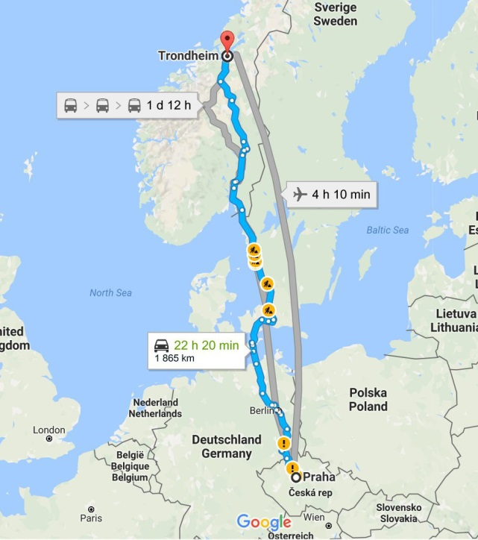
Network propagation delay
Example: Prague to Trondheim
$ traceroute www.ntnu.edu
traceroute to www.ntnu.edu (129.241.56.117), 30 hops max, 60 byte packets
1 r112-gw.cesnet.cz (195.113.144.225) 1.460 ms 1.567 ms 1.721 ms
...
14 lvs56vip27.it.ntnu.no (129.241.56.117) 44.238 ms 44.218 ms 44.226 ms
Network propagation delay ≈ 14 routers x 1 ms +
1865 km / 200 000 km/s = 23 ms
RTT reported by traceroute was 44 ms => one-way delay 22 ms
Notes:
6

Slide 7
Transmission equipment (codec)
Added delay:
LoLa software: from ~5 ms
MVTP hardware: from ~5 ms
Ultragrid software: ~40 ms
Jacktrip software: fluctuates ~30 ms
“From” means with lowest possible buffering configured. To compensate network packet jitter, higher buffering may be needed.
Notes:
7

Slide 8
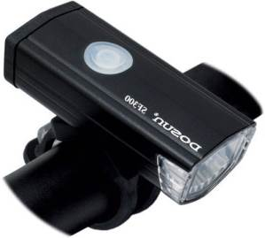
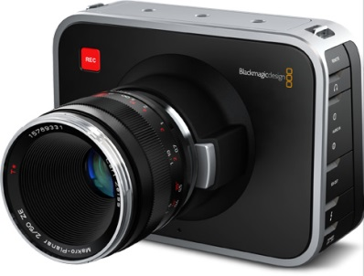
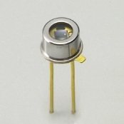
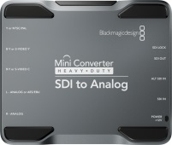
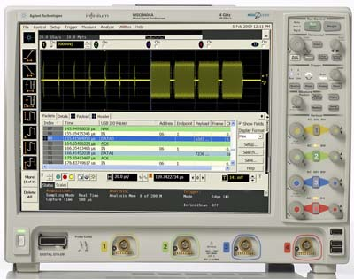
Camera video delay
Flash light
SDI to analog
Photodetector
Two channel
oscilloscope

Slide 9
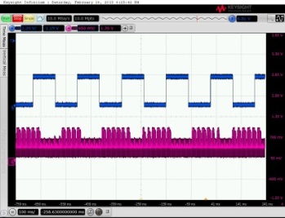
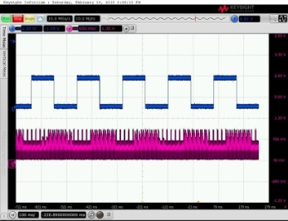
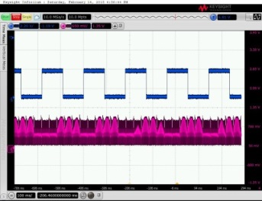
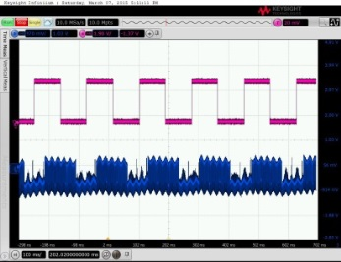
Camera video delay measurements
Canon Legria M56 (consumer HDMI camera):
video delay 100 ms
GoPro Hero4 Black Edition:
video delay 60 ms
Blackmagic Design Production 4K:
video delay 60 ms
Sony XC-HR70 (analog output):
video delay 25 ms
Observation: commercial cameras add video delay at the order of tens of ms from the scene to the output signal

Slide 10
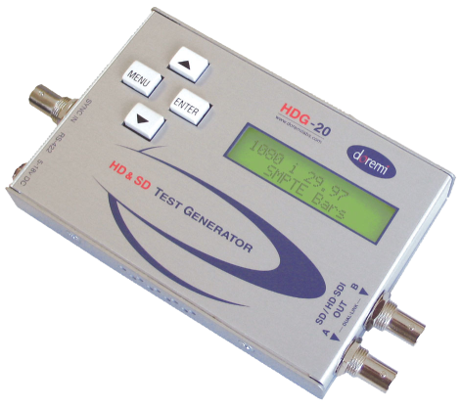
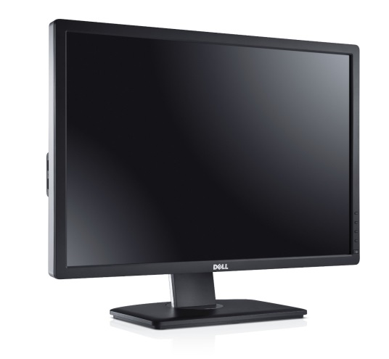
TV / projector video delay
SDI to HDMI / DVI
video generator,
SDI output
SDI to analog
Photodetector
Two channel
oscilloscope

Slide 11
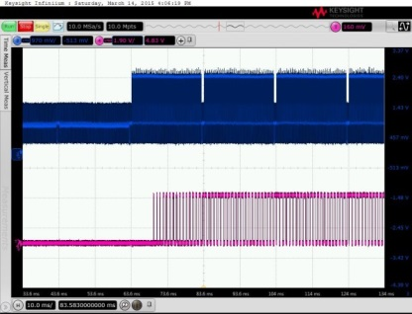
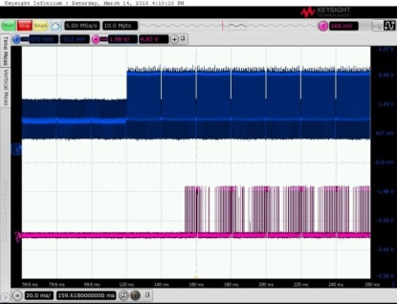
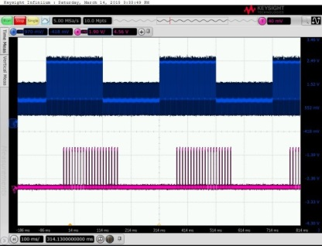
TV / projector delay measurements
ACER Full HD LCD monitor
HDMI input DVI input
video delay 16 / 36 ms
Projector Optoma LH501 (Full HD)
HDMI / DVI / analog input
video delay 60 ms
Observation: thanks to the gaming industry, LCD manufacturers have great incentive to minimize delay, do not trust advertised response of “1.5ms” and like, but there are LCDs with <10 ms delay, see database at www.displaylag.com. Projectors have much higher delay.

Slide 12
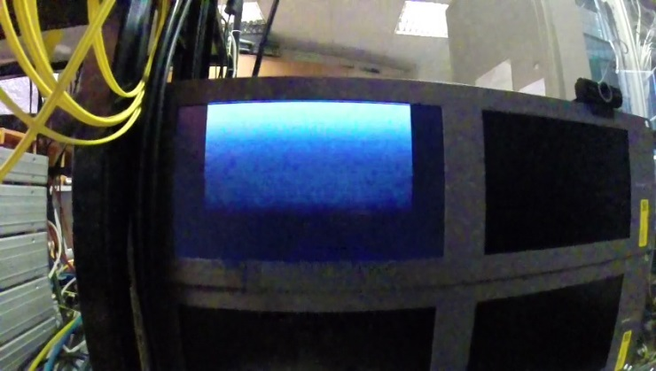
Placement of photodetector
Monitor normally changes a frame from top to bottom, which should be considered when placing a photodetector, here black-to-white frame change is captured by GoPro in 720p240 mode

Slide 13
Frame change observed at 5000 fps
Frame change captured before and after network transmission using a high-speed camera at 5000 fps

Slide 14
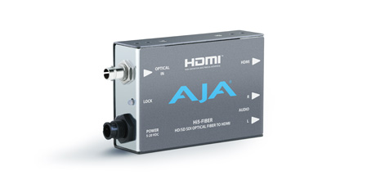
Audio & video converters
Converters are often needed to change video interface (e.g. HDMI vs. HD-SDI) or to embed / disembed audio into video for transmission
Video converters without frame buffer cannot change frame rate
Video converters with frame buffer can also change frame rate

Slide 15
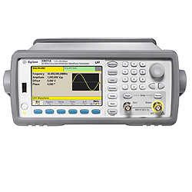
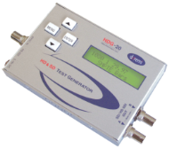
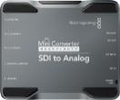
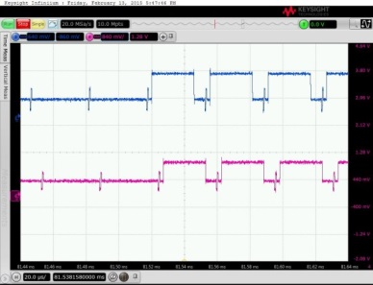
Audio & video converters
audio
convertor
video
convertor
Sin wave 1 kHz in bursts
SDI video generator
2x digital
to analog
Two channel
oscilloscope
Blackmagic HDMI to SDI + AJA HDMI to SDI (Hi5-3G)
video delay 8 microseconds
Two channel
oscilloscope
Observations:
video converters without frame buffer add max. 1-2 ms video delay => no problem
with frame buffer add ~25-30 ms => avoid

Slide 16
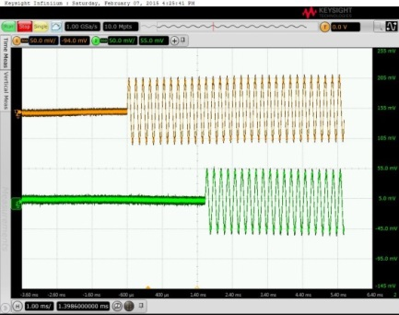
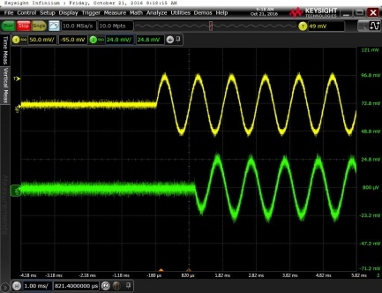
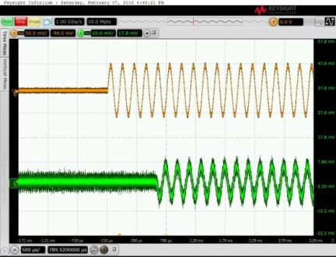
Audio dis/embedding delay
2x AJA HD10AMA (embedder + disembedder)
audio delay 2.2 ms
Datavideo DAC-91 + DAC-90 (embedder + disembedder)
audio delay 1.2 ms
Blackmagic HDMI to SDI + AJA Hi5-3G (embedding + disembedding in video converters)
audio delay 800 microseconds
Observation: audio dis/embedding delay is small in both dedicated dis/embedders and in video converters

Slide 17
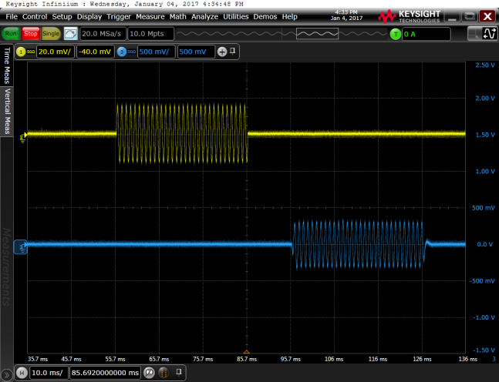
Camera audio embedding delay
Panasonic HC-V750
audio delay 40 ms!
Observation: audio embedding in cameras tends to synchronize audio with its video and adds tens of ms delay to audio => avoid and use external embedder

Slide 18
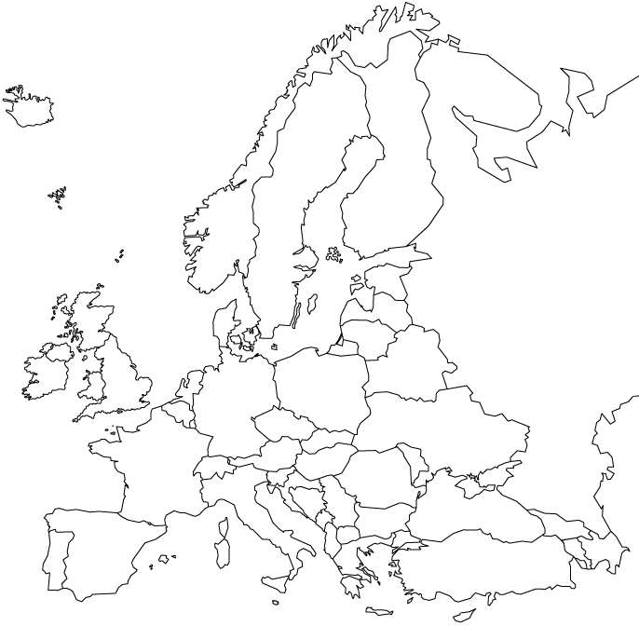
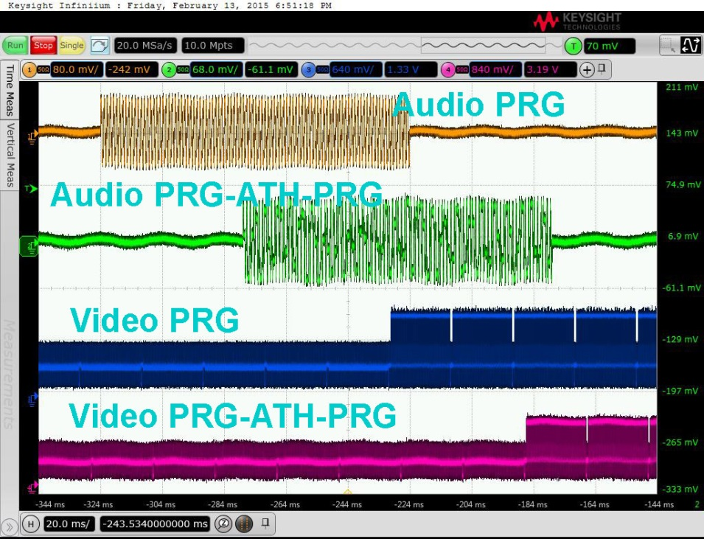
Audio & video over network
Network loop was established using GRE tunnels to test a network path before the event. It allows delay measurement over a network
Prague
Athens
Loop Prague – Athens – Prague
2x MVTP hardware, audio embedder, disembedder
Total audio and video delay 48 ms (ping RTT 36 ms + A/V equipment 12 ms) => one way delay ~30 ms

Slide 19
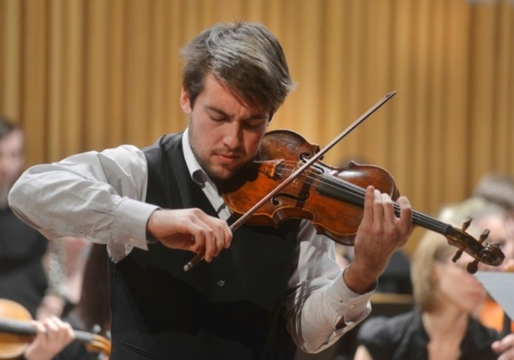
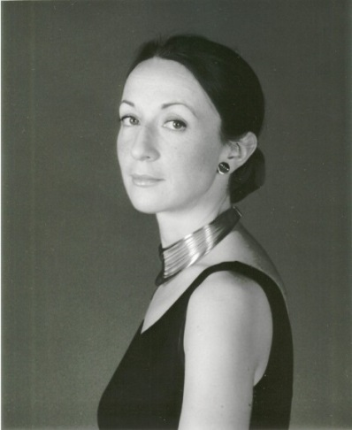
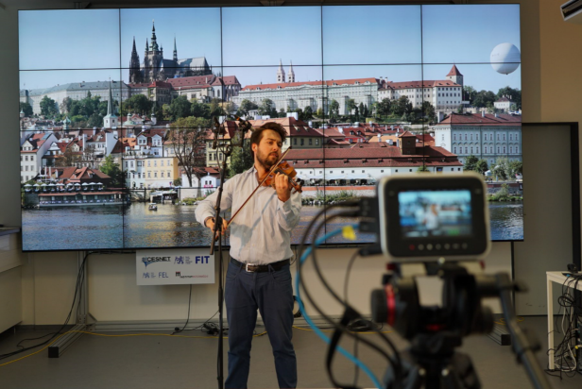
Example: classical music over 1000 km
Matous Peruska, violin
London, RCM
Amsterdam
Frankfurt
Alison Rhind - piano
Prague, AMU / SAGElab

Slide 20
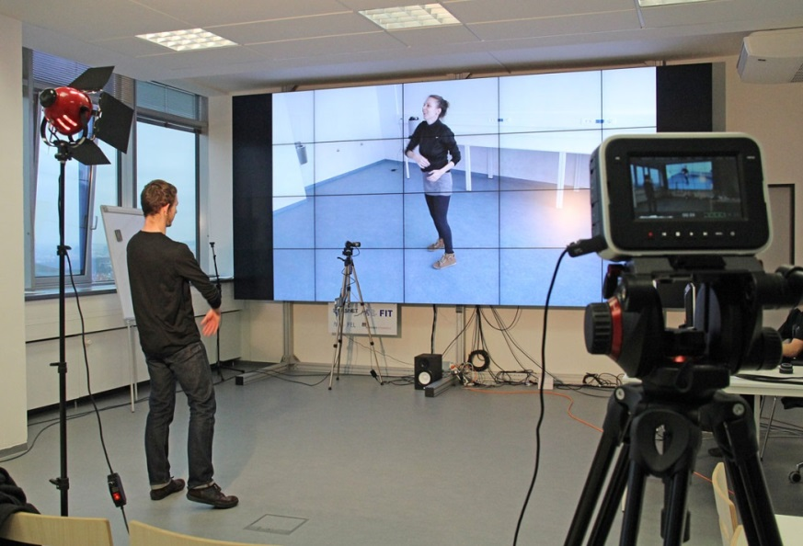
Dance with delay
SAGElab Network Visualization Laboratory (CESNET/CTU)
Experiment: evaluation of delay effects on dance performance
Dancers were exchanging a “virtual ball”
Minimum video delay was limited by cameras and monitors to approx. 100 ms
Observation: dancers could synchronize with added video and audio delay up to 250 ms
Valid for this particular performance, but gives a hint that dance can tolerate higher delay
Notes:
20

Slide 21
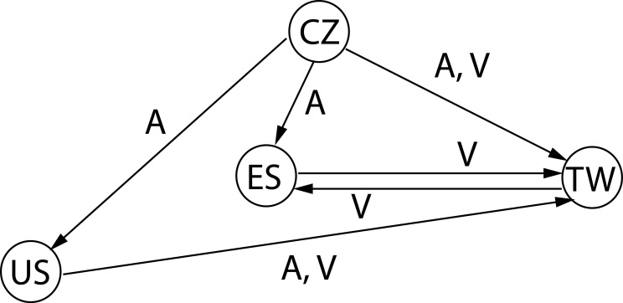
Cyber Performances
Depending on the graph of dependance between musicians and dancers, higher delays can be accommodated to create a “cyber performance”
a circle in audio transmissions => audio delay between any two nodes in the circle < ~30 ms
a circle of video transmissions => video delay between any two nodes in the circle < ~250ms
more alternative directed paths ending by audio transmissions between a pair of nodes => difference in audio delay of each path < ~30ms
more alternative directed paths ending by at most one audio and one or more video transmissions between a pair of nodes => difference video delay of each path < ~250ms

Slide 22
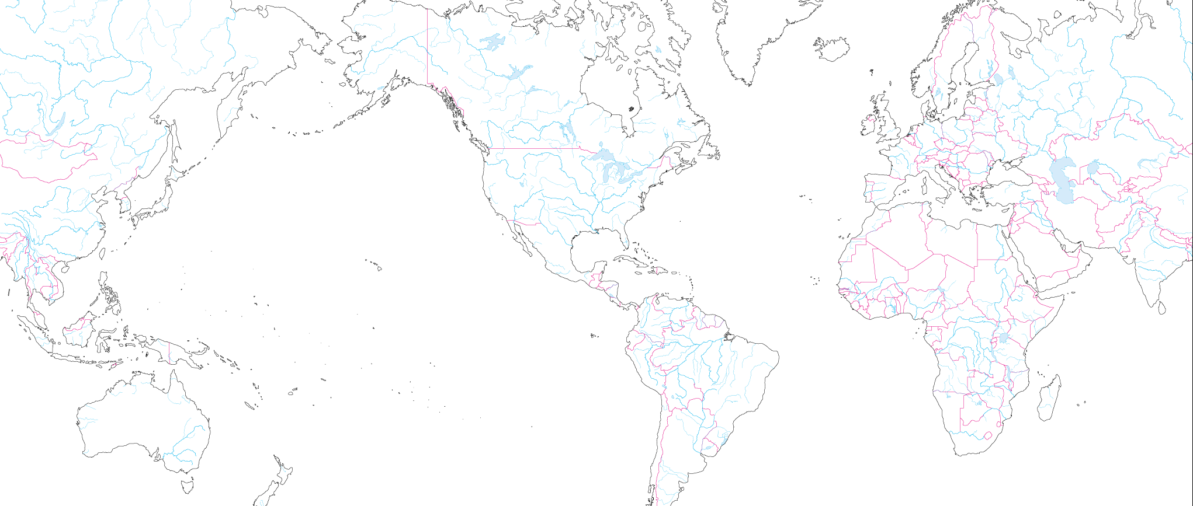
Example: 3 continent cyber performance
„Dancing in space“, for the APAN 38 meeting in Taiwan, August 2014
Live performance between Prague, Barcelona, Miami and Taiwan
Amsterdam
20G
10G
To be filled
Chicago
10G
Prague
APAN38
NanTou
20G
10G
Barcelona
Miami
Taipei
10G
20G
NanTou

Slide 23
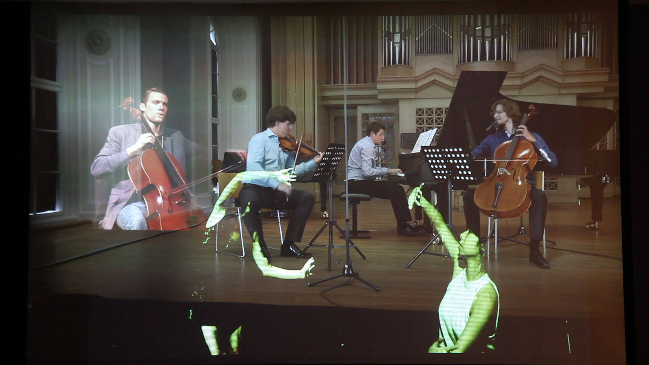
Main stage in Nantou, Taiwan
Music in Miami:
Musical trio in Prague
Dance in Barcelona
Dance in Taiwan
Notes:
23

Slide 24
Conclusion
We can now add min. ~5 ms audio delay and ~40 ms video delay to the network propagation delay
Many practical use cases actually do not need very low delay due to “turn over to you” nature - distance master classes, entrance examinations, auditioning
Beyond low audio delay, musicians often miss the „feel“ of fellow musicians
Experience can be improved by multi-channel audio, room emulation with comparable echo, dynamics, etc.

Slide 25
Thank you for your attention!
Sven Ubik, Jiří Melnikov
ubik | melnikov @cesnet.cz
Notes:
25

