Slide 1
Internet2 Introduction & Cultural Initiatives
Ann Doyle, Internet2
Network Performing Arts Production Workshop
Royal Danish Academy of Music
April, 2017
© 2016 Internet2

Slide 2
Internet2’s Current Services and Programs
Membership
  Community convening, engagement, meetings
  Collaborative Innovation Community Workgroups
Network
  100 G channels; 8.8 Tbps total capacity
  Global peering and services
Identity and Access Management:
  InCommon
  TIER
NET+
  Contracts
  Pricing

Slide 3
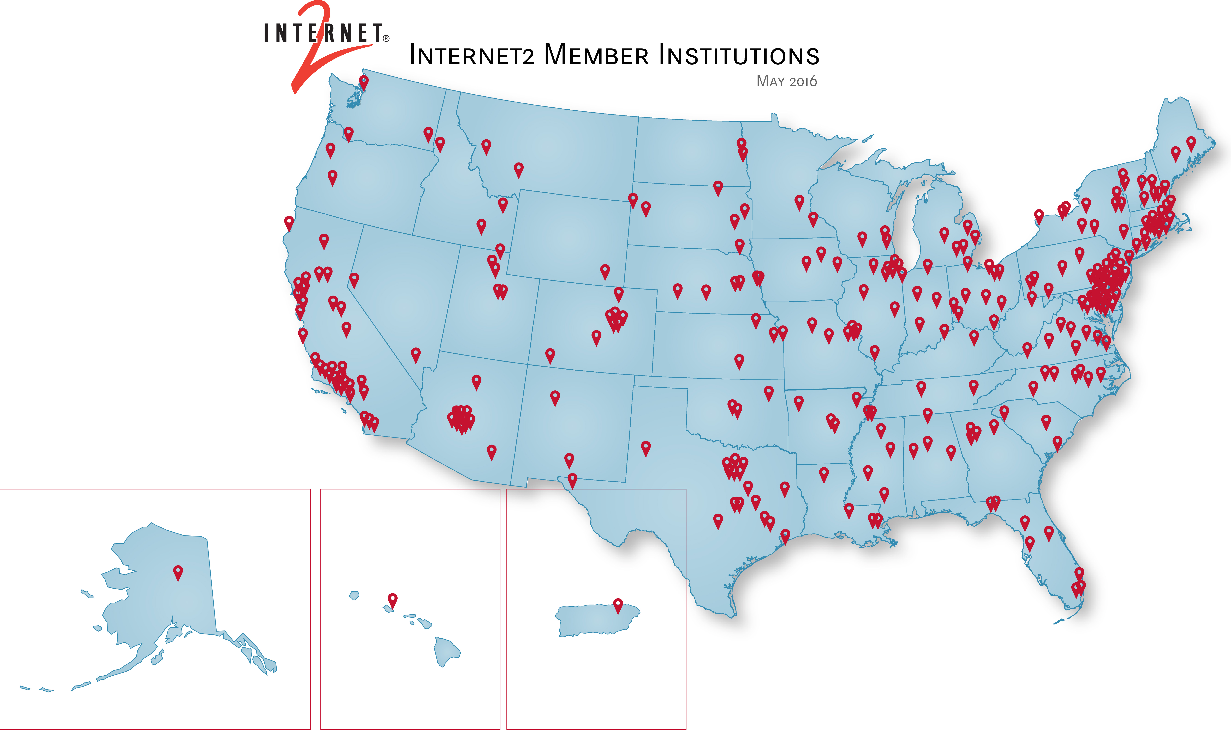
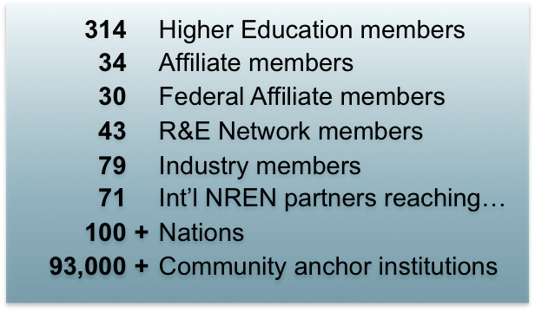

Slide 4
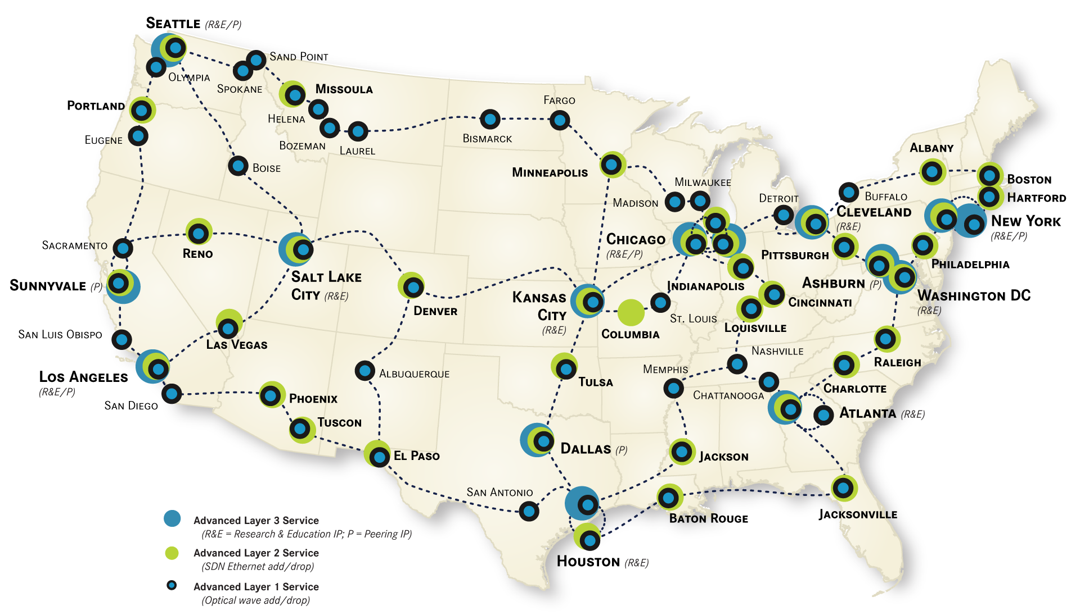
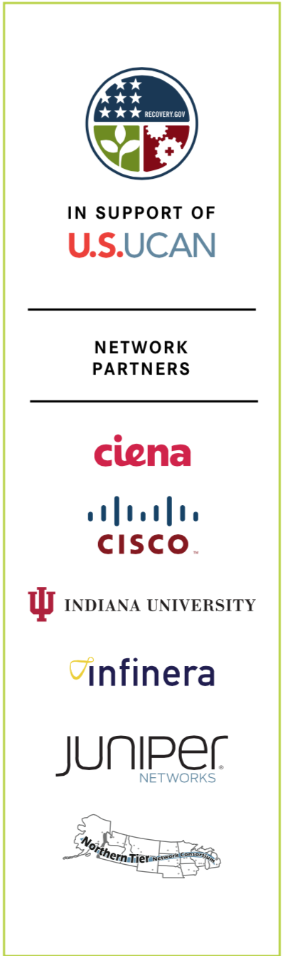
Internet2 Network Infrastructure Topology

Slide 5
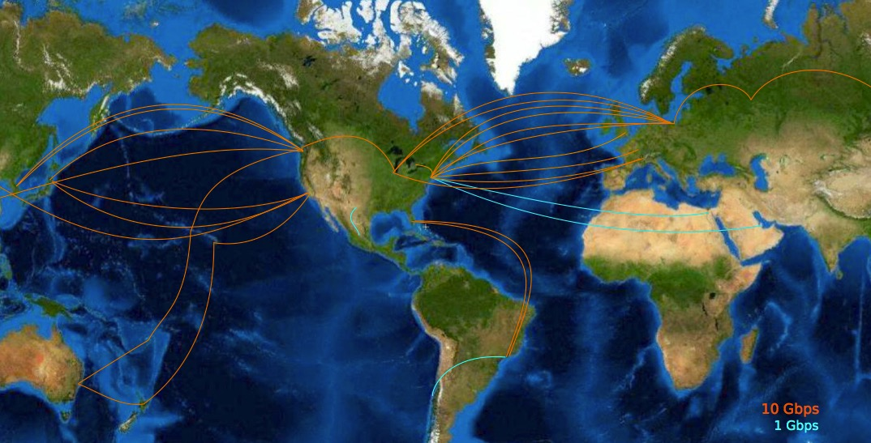
International reach
US-based Exchange Points
StarLight, Chicago IL
MAN LAN, New York NY
NGIX-East, College Park MD
AtlanticWave (distributed)
AMPATH, Miami FL
PacificWave-S, Los Angeles CA
PacificWave-Bay, Sunnyvale CA, Palo Alto CA
PacificWave-N, Seattle WA
4
Notes:
[>>] Map showing international links INCLUDING Canada, Mexico, and Latin America –
Wendy: Some summary information or a key - It is not clear what the blue area's correspond to.
Jason: This would be two part - the names of the exchange points as well as the links. Notes that some links are 'public' (e.g. NSF funded), others may be private to a VO or consumer class (e.g. DOE's funding of USLHCnet). This may be too much detail. The links and exchange points are sometimes operated by different parties (e.g. an 'open' exchange in Amsterdam may have 20 links from different people funded in different ways). This is a bit of a rat hole I think, if we start giving complete information, we will be forced to make sure it is 100% accurate at all times.
Doug: I’ve asked Jason for info on exchange points he wants to see here - also checked with Edward Moynihan, as I suspected the "Reachable Networks" map on this slide was out of date.
It is, and he's working on a dynamically updated solution, but until he gets it, we're stuck with this, or one of the more recently updated ones (like http://www.internet2.edu/pubs/internationalpartners.pdf), but that doesn't have the connection lines...
We can list major R&E exchange points as 'examples', and maybe highlight specific links (e.g. LHCOPN, IRNC links, etc.).
image: international partner reach

Slide 6

Arts and Humanities Partnerships

Slide 7
Key U.S. participants
  U.S. University Members – Departments of Music, Dance, Art, English, History, etc.
  Affiliate Members –Berklee College of Music, Cleveland Institute of Music, Library of Congress, Manhattan School of Music, New World Symphony,The Smithsonian, and others.
  USC Shoah Fondation Institute, EVIA Ethnomusicology repository, C-SPAN and Research Channel video archives, etc.

Slide 8
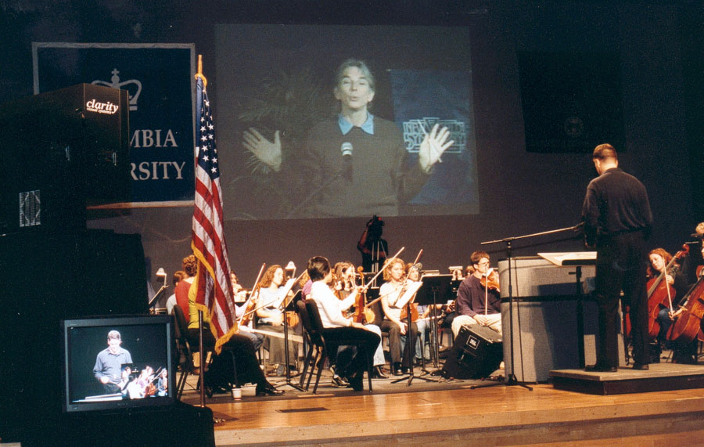
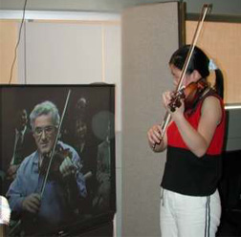
Master Classes
Active involvement…
  Cleveland Institute of Music
  Eastman School of Music
  Indiana University
  Manhattan School of Music
  New World Symphony
  Northern Illinois University
  Philadelphia Orchestra
  University of Michigan
  University of Southern California
  And many others……
Michael Tilson Thomas
Pinchas Zukerman

Slide 9
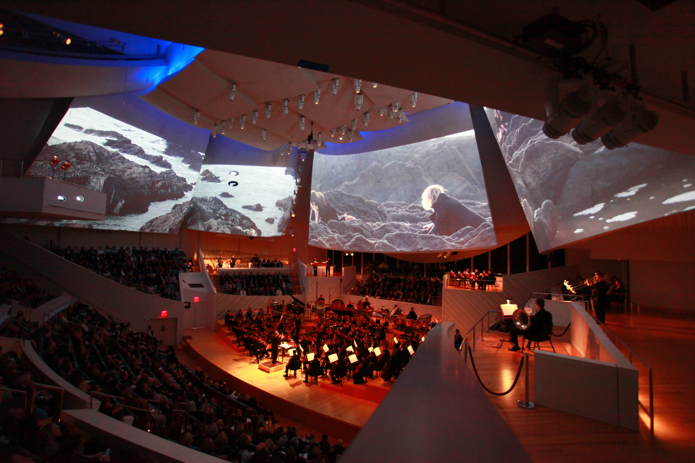
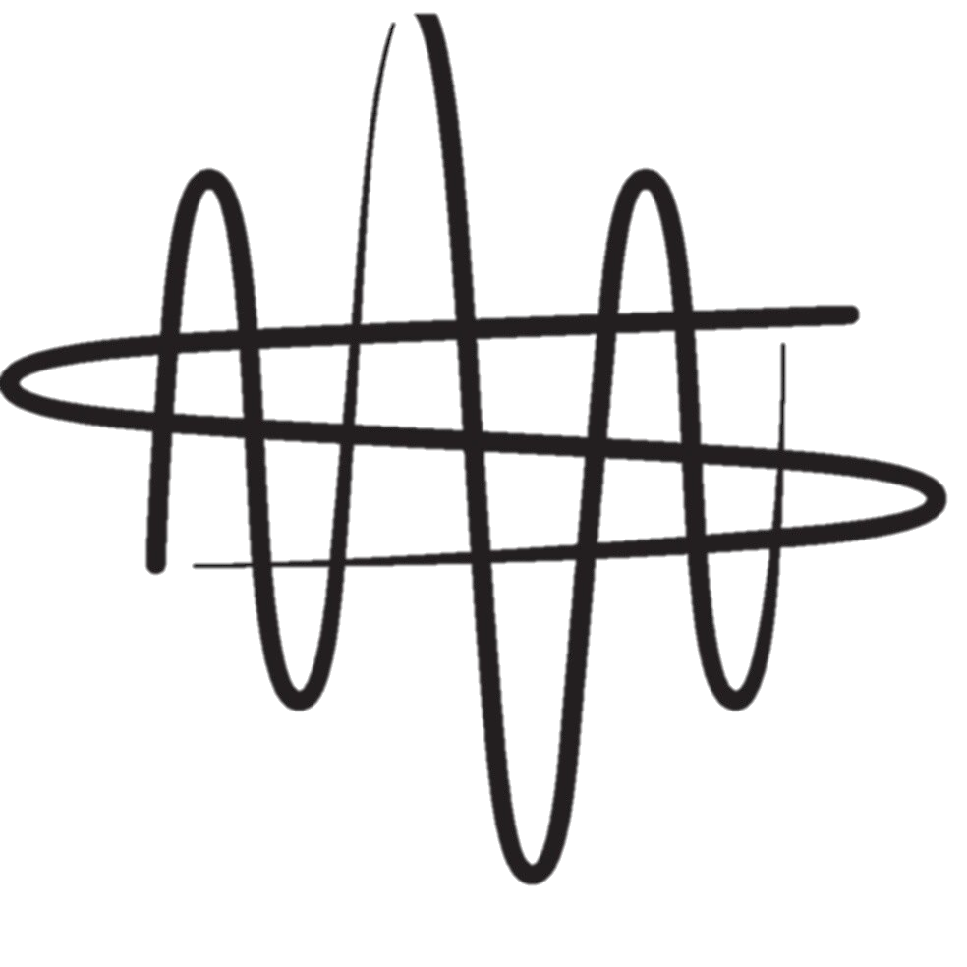
Multisite Performance
New World Symphony
www.nws.edu

Slide 10

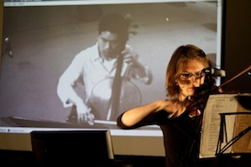
LOLA
Simultaneous performance
Violinist Marjorie Bagley, University of North Carolina. Greensboro
Cellist Cheng-Hou Lee, Northern Illinois University (NIU)

Slide 11
Global Audition Training Project
To examine the subtle cultural and geographical
differences in both orchestral auditions and repertoire
Five Partners: Royal Danish Academy of Music, Shanghai
Conservatory, Cleveland Institute of Music, University of
Music and Performing Arts (Vienna), and NWS
2-3 sessions a year, each of which features a prominent
professional player and student from each site
www.nws.edu

Slide 12
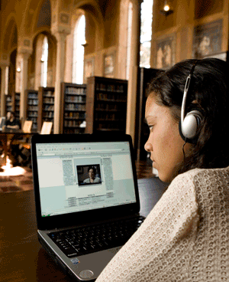
Collections
                USC Shoah Foundation Institute For Visual History and Education – 180 terabyte multimedia archive of Holocaust testimonies
                EVIA -- Ethnomusicology repository; 300 plus hours of digital video and metatdata
                C-SPAN Video Library and Archive -- 80,000 hours of programming
                Research Channel -- 2800+ programs available on-demand
                MUSAIC – New World Symphony

Slide 13
Network Performing Arts Production Workshop A long history!!
  2004: Internet2 and New World Symphony and host first annual Performance Arts Production workshop
  2005: GARR and New World Symphony host demonstration at GARR annual user conference
  2006: Ann Doyle presents at TERENA, and discussions begin about TERENA hosting in Europe
  2009: First European Performing Arts Production Workshop in Trieste, with GARR
  2010: 2nd European workshop: IRCAM/COMEDIA with RENATER
  2011: 3rd European workshop: Gran Teatre del Liceu, Barcelona
  2012: New World Symphony, Miami Beach
  2013: University of Music and Performing Arts, Vienna
  2014: New World Symphony, Miami Beach
  2015: GÉANT Association, Jisc, Royal College of Music, Internet2
  2016: New World Symphony, Miami Beach

Slide 14
And here we are!!
Royal Danish Academy of Music

