Slide 1
Producing and Staging Networks Performances
Maria Isabel Gandía Carriedo
NPAPWS 2018
New World Symphony, Miami, 26-04-2018

Slide 2
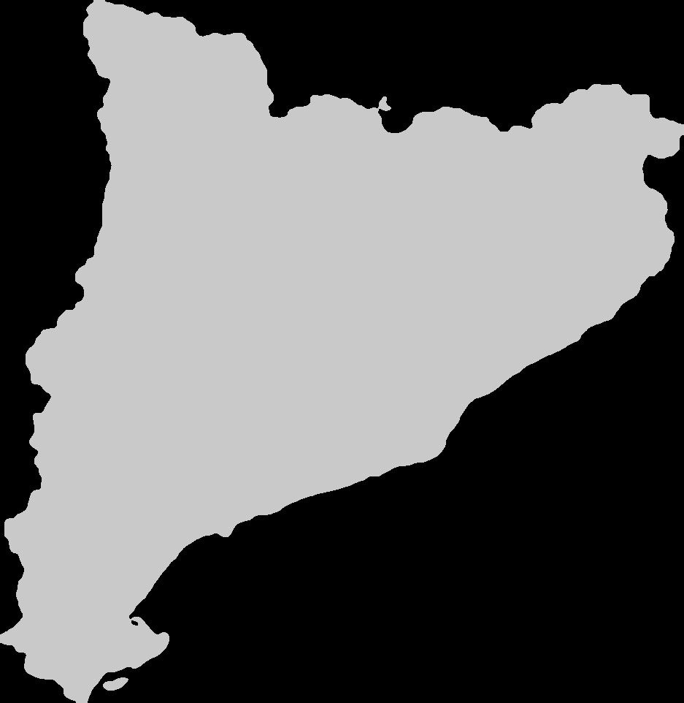
CSUC is a Consortium of 10 Universities and the Catalan Government.
“Collaborating and Sharing to Improve the University System“

Slide 4
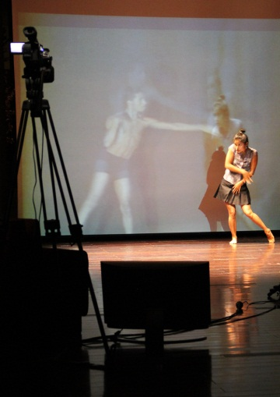
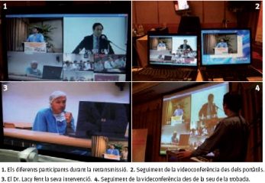
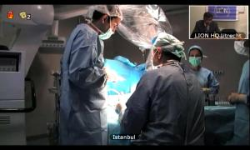
The Network: Anella Científica
Regional Research & Education Network in Catalonia
81 institutions, 91 points of access, 128 connections
Universities, Research Centers, Digital content
Connected to RedIRIS
A traditional technical supporter of remote network collaborations
Network and Performing Arts
Telemedicine
Videoconferences
Notes:
Opera Oberta (2001-2014)
E-Pormundos afeto (2011)
Near in the distance (2013)
Near in the distance 2 (2015)
The Infinite Bridge (2015)
Longing for the Impossible for the moment it is real: Copenhaguen calling London & Barcelona (2017)
Similarities (2017)
Near in the distance 3 (2017)

Slide 5
Rehearsing Remotely
Captura: Alain Baumann
Notes:
With the Opera Oberta courses, we had fixed dates for rehearsals every month, but it was mostly to test the network & multicast connectivity for all the universities, these were rehearsals for the technicians
When it comes to multi-site performances, and I’m talking specially about dance performances, artists should agree first on what they are going to do. They can use standard VC systems to meet, chat, prepare some ideas.
Ideally, when the performance is approaching:
- First, check the network and all the technical stuff with the technician on the other sites and once everything is solved, artists can rehearse better.
Having a conductor for all the sites with a clear idea of how the performance should look like makes it easier for the remote sites that don’t have a whole picture of what is happening.
Having someone on te main site to give the cues via a separate channel and someone on-site to tell them when every cue is announced helps the artists.

Slide 6
Rehearsing Remotely
Alain Baumann

Slide 7
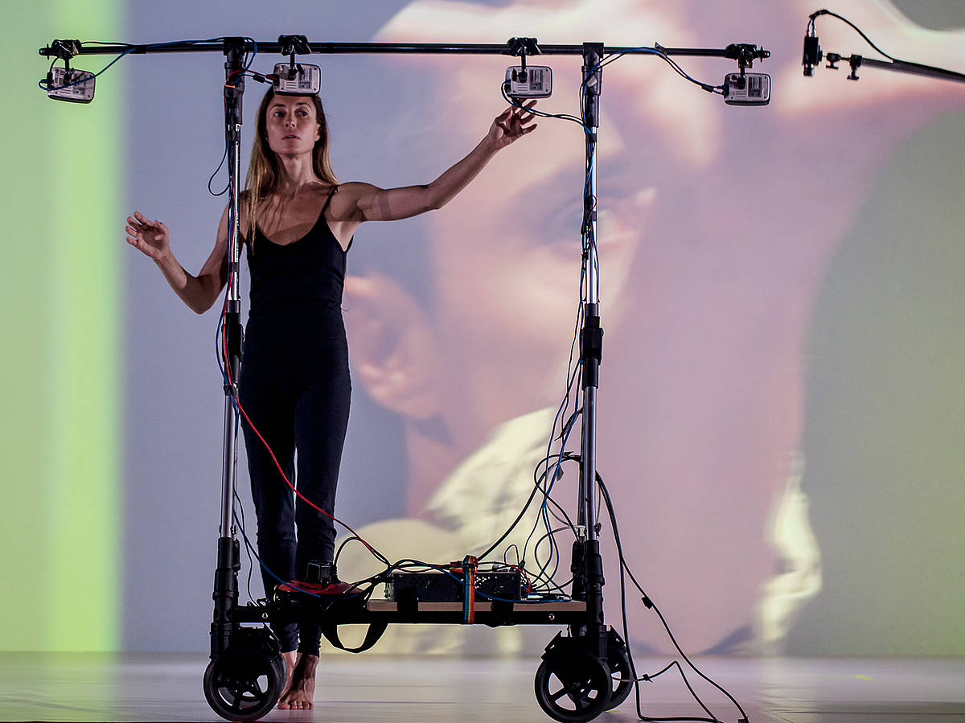
Rehearsing Remotely
Koniclab.alcañiz2015

Slide 8
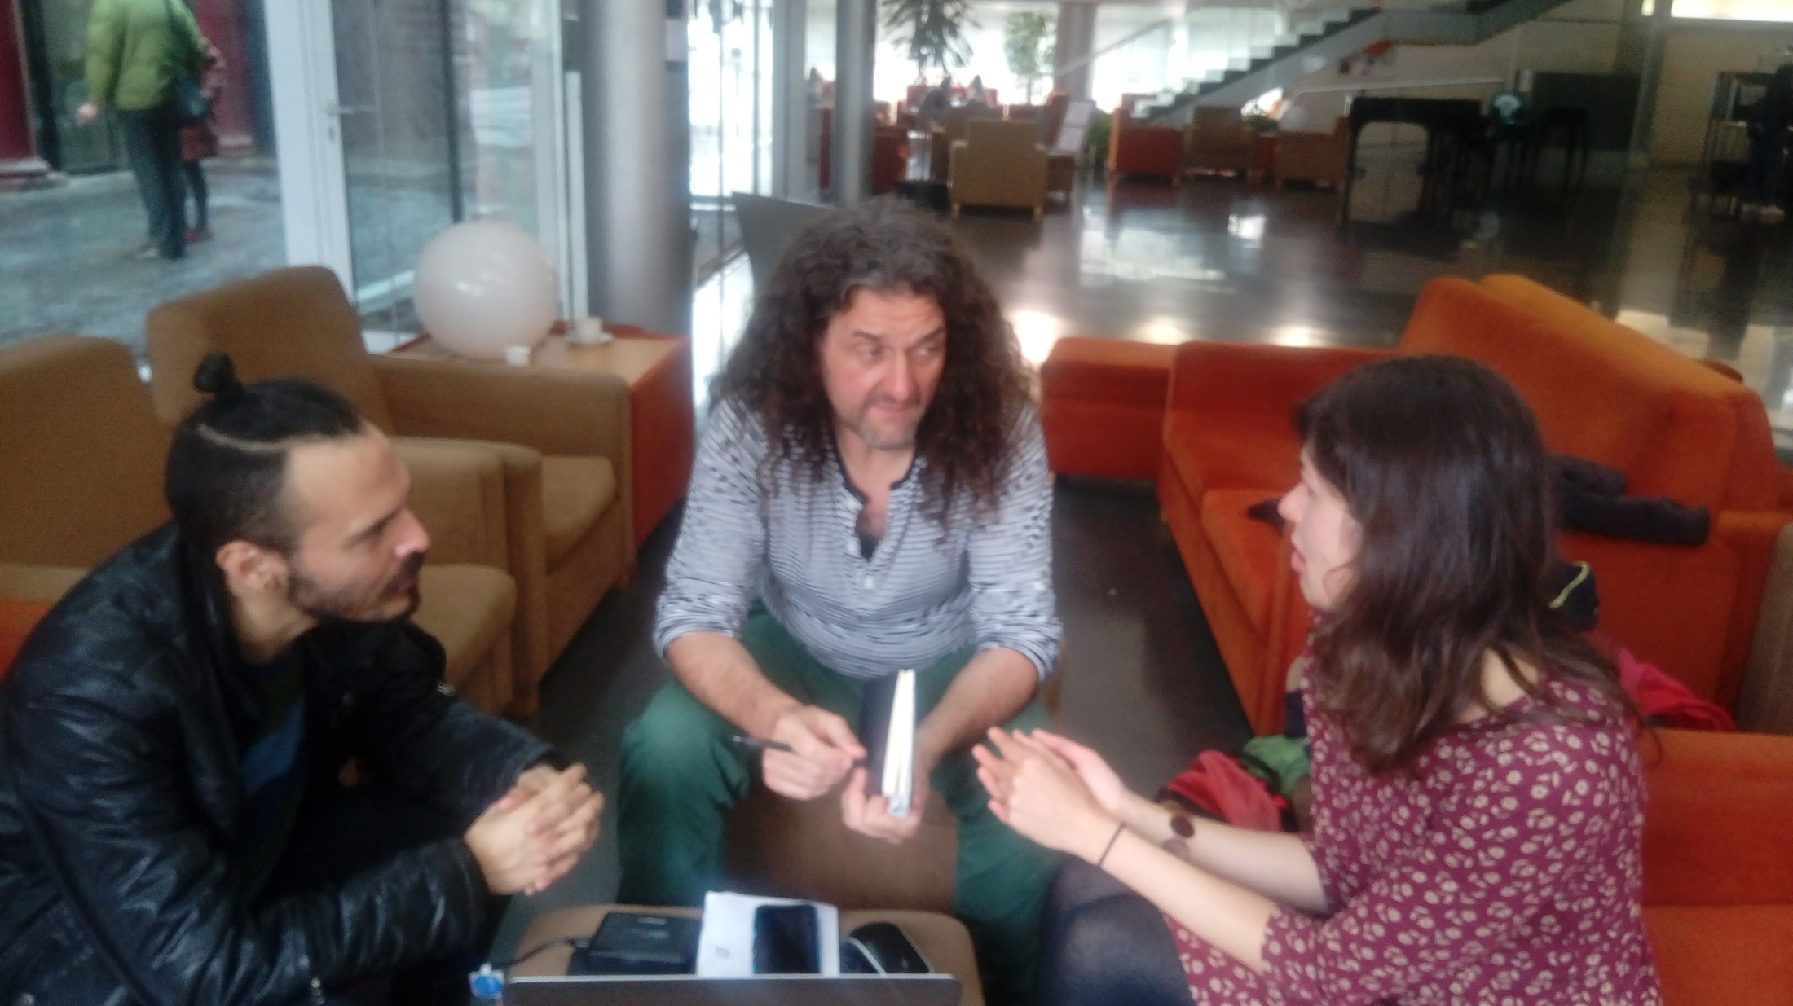
Physical/In-Person Meetings
Notes:
In-person meetings are not mandatory, but they really help. Jana and Ian came to Barcelona a couple of months before the PULSAR festival and the students met them, they were able to chat and discuss possible ways of doing things during the performance and it helped. On the other hand, if this is not possible, VC and some informal chats always help.

Slide 9
Partners: People and institutions make remote performances possible!
THANK YOU!!!

Slide 10
Partners: People and institutions make remote performances possible!
Adolf Alcañiz
Ángel Fernández
Claudio Allocchio
Francisco Banderas
Alain Baumann
Ian Biscoe
Jana Bitterová
Ulf Busch
Valentino Cavalli
Xavier Carreras
Ann Doyle
Gemma Felius
Irene García
Elia Genís
Dominik Grunbuhel
Gemma Felius
Anna Hierro
Miquel Huguet
Fran Iglesias
Juan Luis Jiménez
Sigita Jurkynaite
Andrea Just
Renate Kreil
Aurelian Krieger
Michael Ladouceur
Neus Ledesma
Tania Lisboa
Pedro Lorente
Victoria Macarte
Julia Osorio
Christian Panigl
Caterina Parals
Jordi Pareto
Matt Parkin
Xavier Peiró
Manel Pérez
Rafel Plana
Miquel Puig
Bruno Ramri
Hermann Rothe
Rosa Sánchez
Emma Smith
Thomas Solak
Peter Szegedi
Teresa Via
Marc Vives
And many, many others

Slide 11
Funding Projects: Space & Material
Jordi Pareto

Slide 12
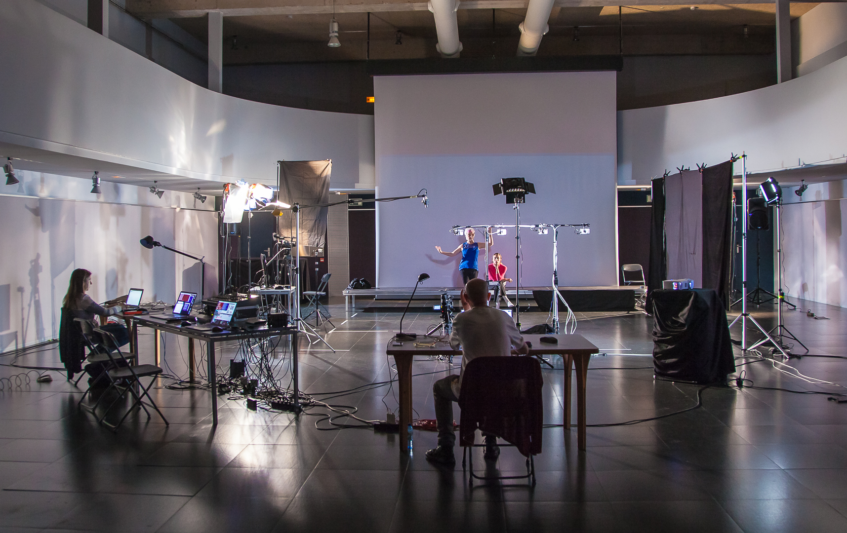
Funding Projects: Space & Material
koniclab.alcañiz2017

Slide 13
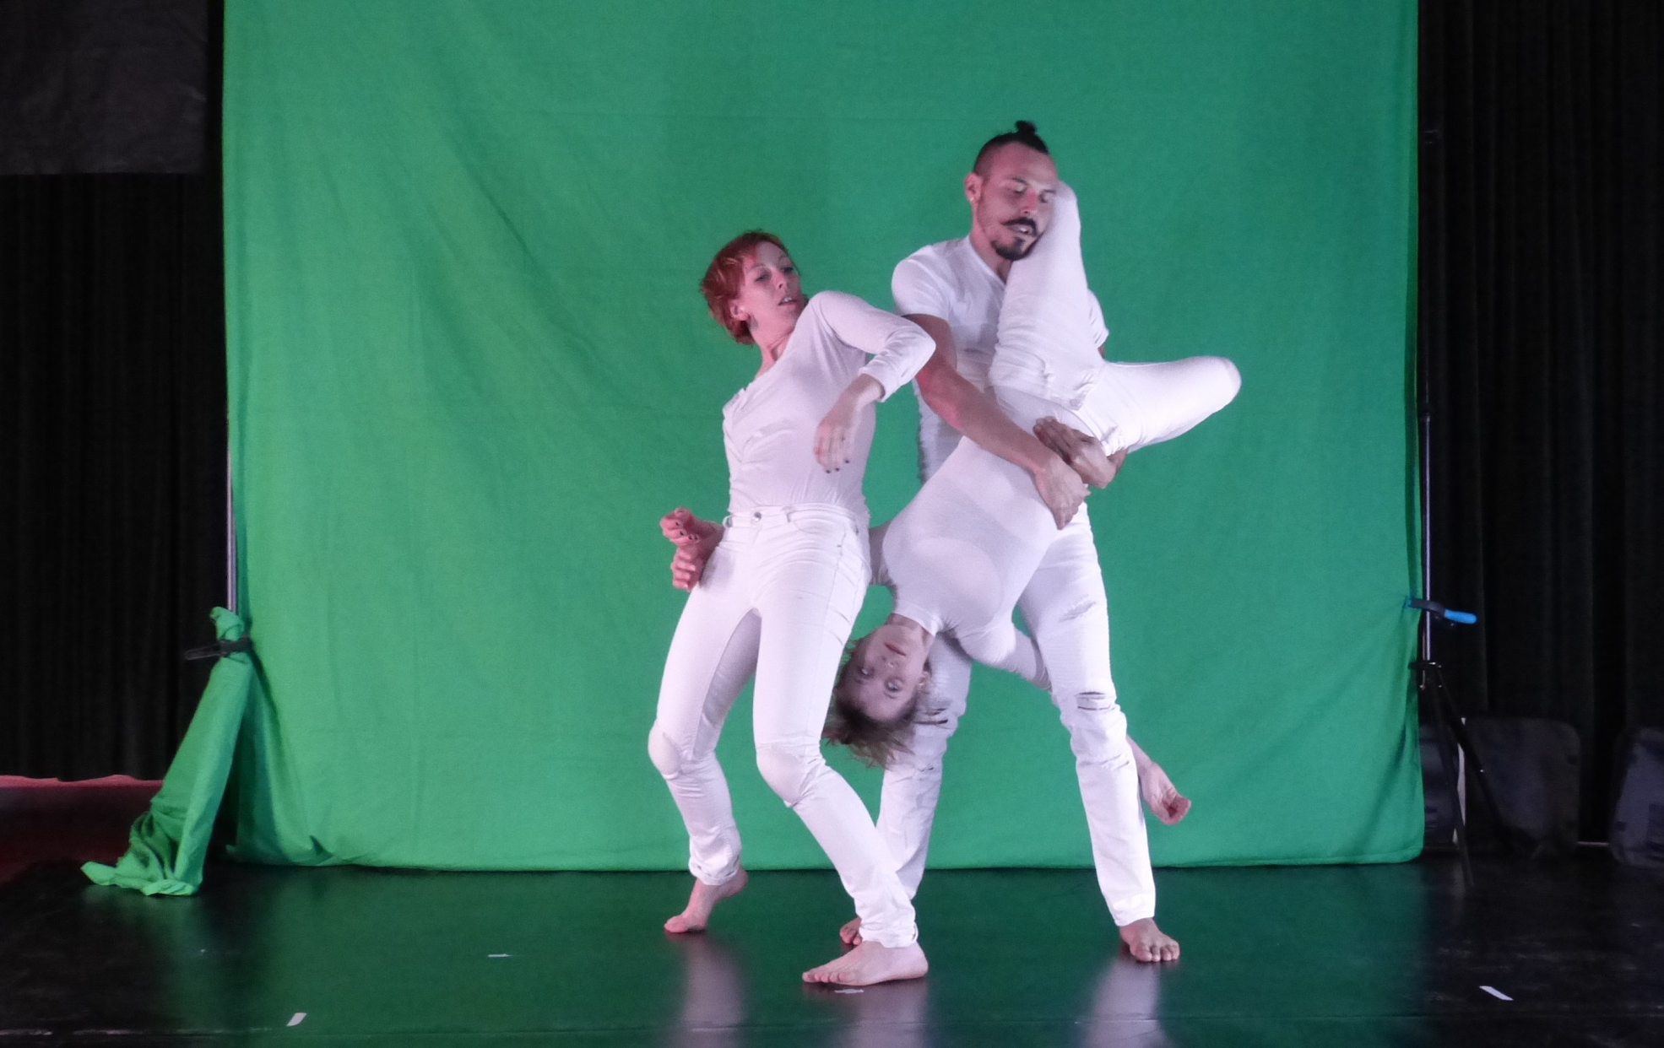
Funding Projects: Artists

Slide 14
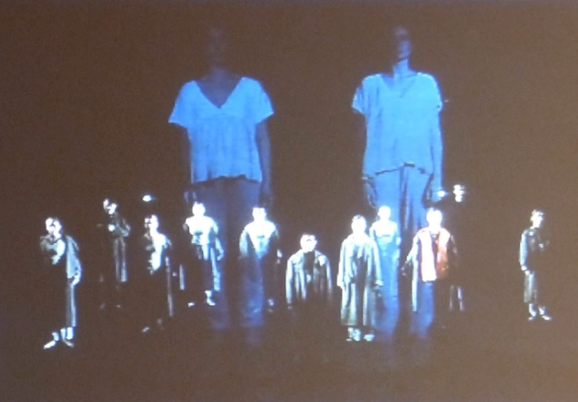
Funding Projects: Artists

Slide 15
Funding Projects: Technicians & Network

Slide 16
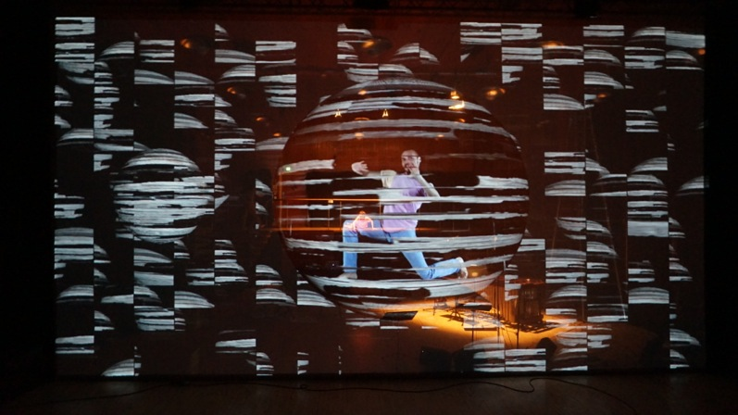
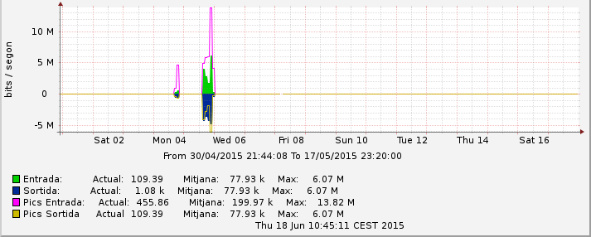
Technologies: Polycom
Thomas Solak

Slide 17
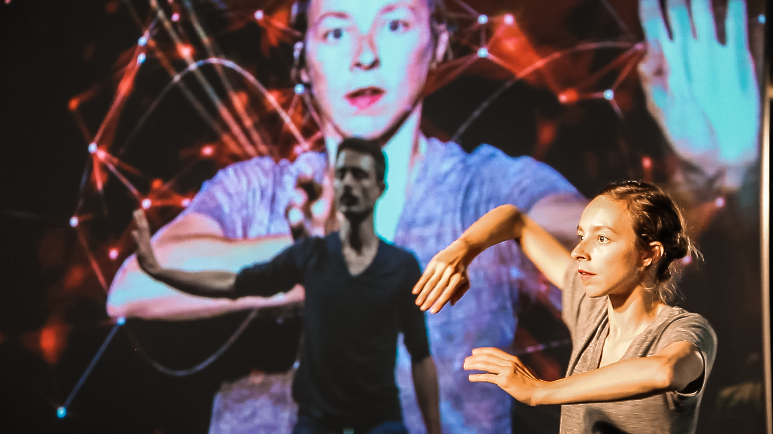
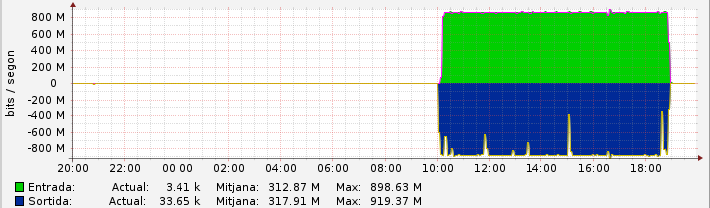
Technologies: Ultragrid
koniclab.alcañiz2017

Slide 18
Technologies: LOLA
Foto y vídeo: Juan Luís Jiménez Tenorio

Slide 19
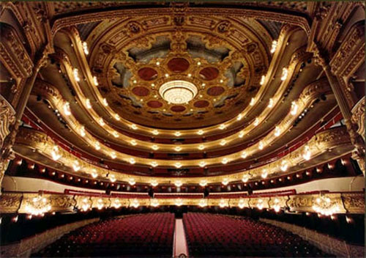
Technologies: Videolan (VLC)
Gran Teatre del Liceu de Bardeclona

Slide 20
Back Channel Communications
Back channel(s)
koniclab.alcañiz2017

Slide 21
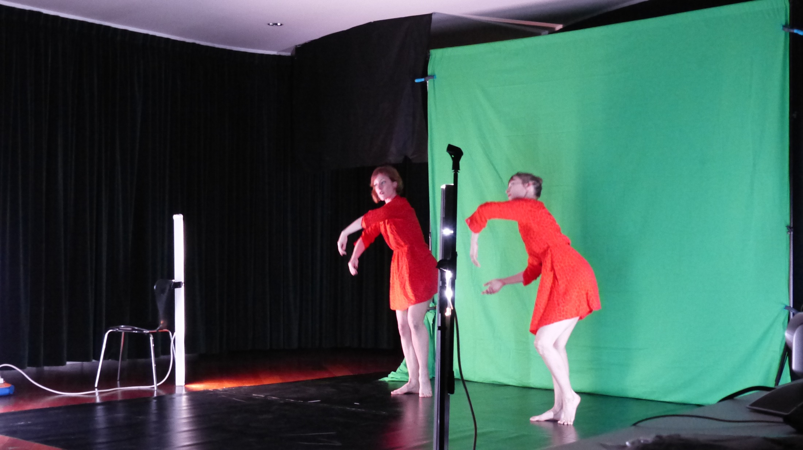
Back Channel Communications: the Mistery of the Green Dresses
All the connections are important, not only the network connections!

Slide 22
Thanks for you attention! Questions?
mariaisabel.gandia@csuc.cat

